Slide 1
Algorithmic Recourse - A Causal Perspective

Slide 2
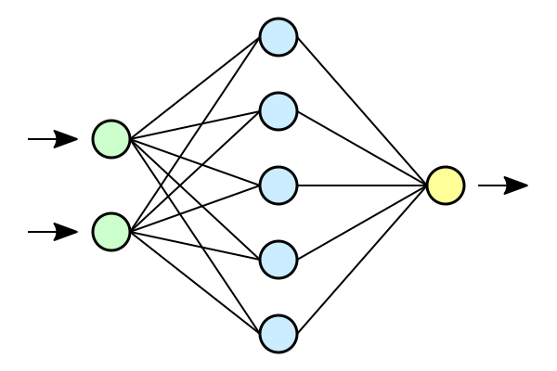
Machine Learning
Input Features X
Output Y
$$X$$
$$Y$$
$${\left|\left|Y −f\left(X\right)\right|\right|}^{2}$$

Slide 3
Spurious Associations
https://icml.cc/media/icml-2022/Slides/17868_ajInNyw.pdf

Slide 4
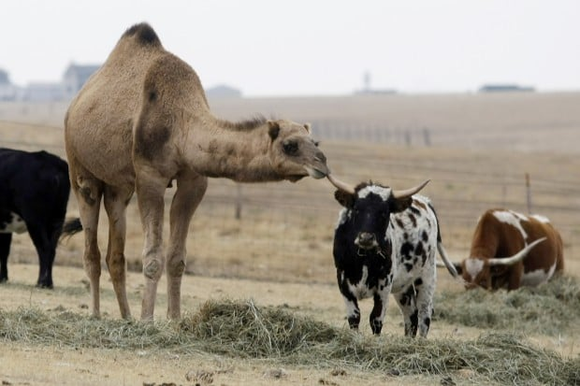
Counterfactuals

Slide 5
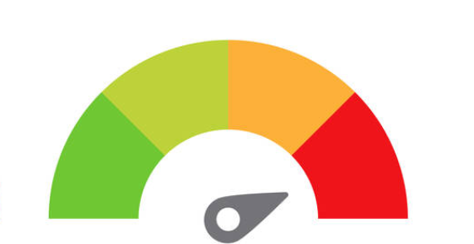
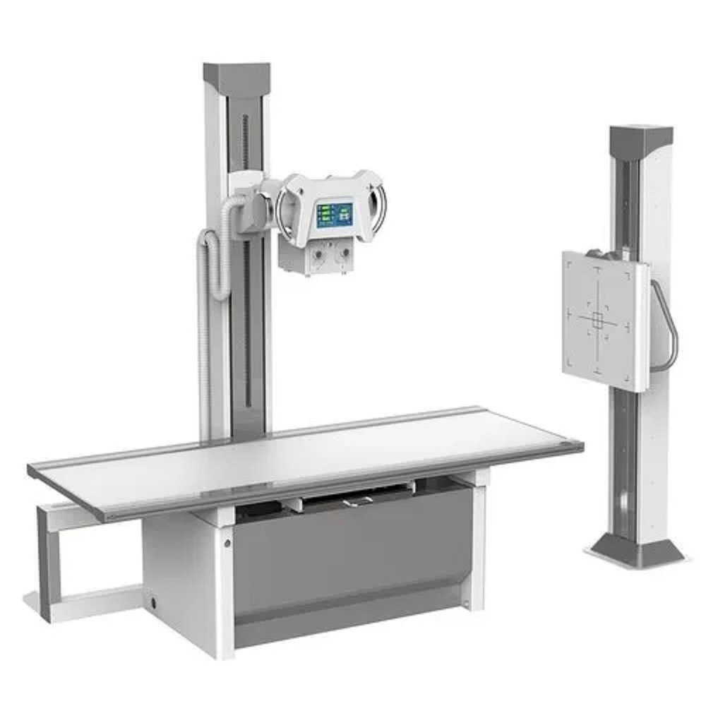
An Xray Example
T
X
Y
Z

Slide 6
Creating Counterfactuals
Abduction
Action
Prediction

Slide 7
1. Abduction
$$^{−1}$$

Slide 8
(2) Action

Slide 9
(3) Prediction
T
X
Y
Z

Slide 10
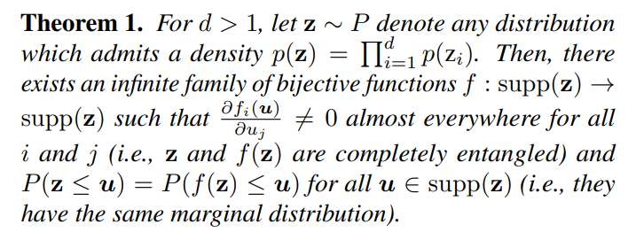
Abduction is impossible -- God save us for steps 2, 3
In English, Given an observational dataset, where for each patient, we have just one Xray, it is impossible to characterize the patient characteristics from whom the Xray was taken.
https://arxiv.org/pdf/1811.12359 -- ICML Best Paper

Slide 11
But without Counterfactuals
Our Maximum Likelihood based training objectives used to train ML models are prone to latch on to spurious correlations in the training datasets.
What to do?
We propose Recourse as one of the possible solutions.

Slide 12
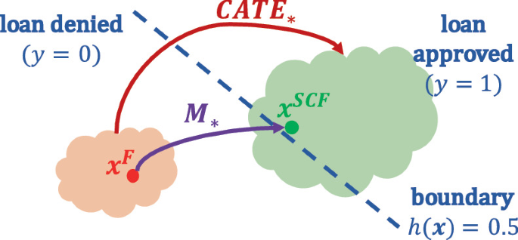
Algorithmic Recourse in Conventional sense
Optimize X for a desired label

Slide 13
Algorithmic Recourse in our sense
NeurIPS-22
Optimize T for the correct label
T
X
Y
Z

Slide 14
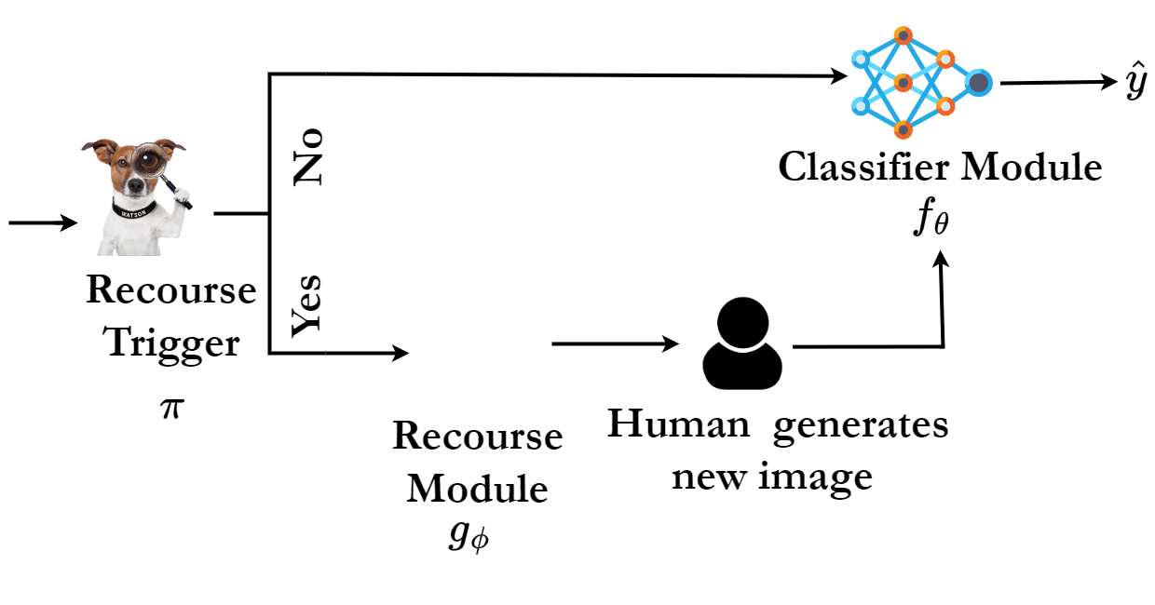
Three Stage Recourse Pipeline

Slide 15
Three Stage Recourse Pipeline

Slide 16
Three Stage Recourse Pipeline

Slide 17
A wise man (who? Me) once said
All models problems are good but some are useful have datasets

Slide 18
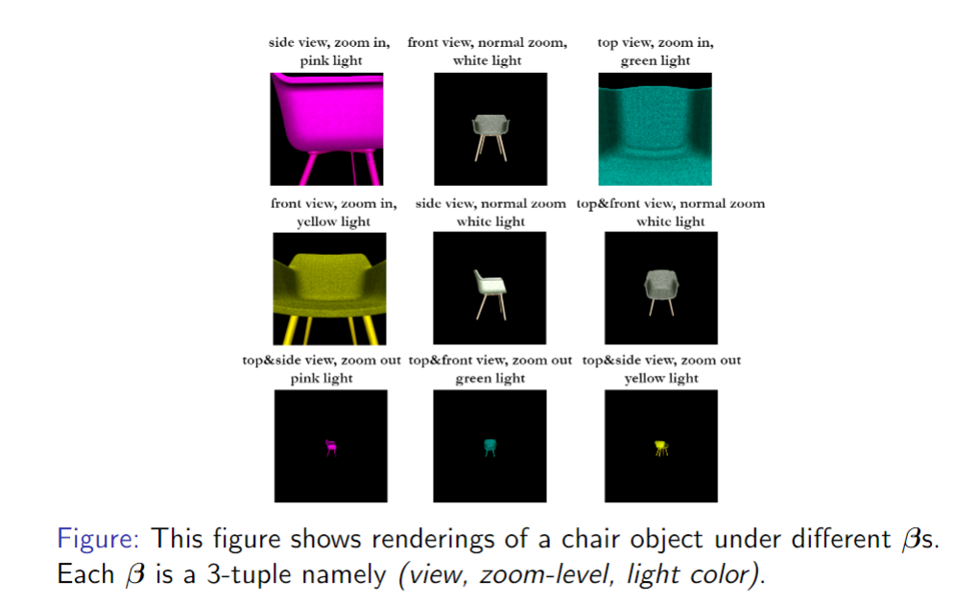
Shapenet

Slide 19
Assumption
We assume counterfactuals in the training dataset.
For each person $i,$we assume multiple Xrays taken under multiple settings
This is unrealistic, we will relax this soon.

Slide 20
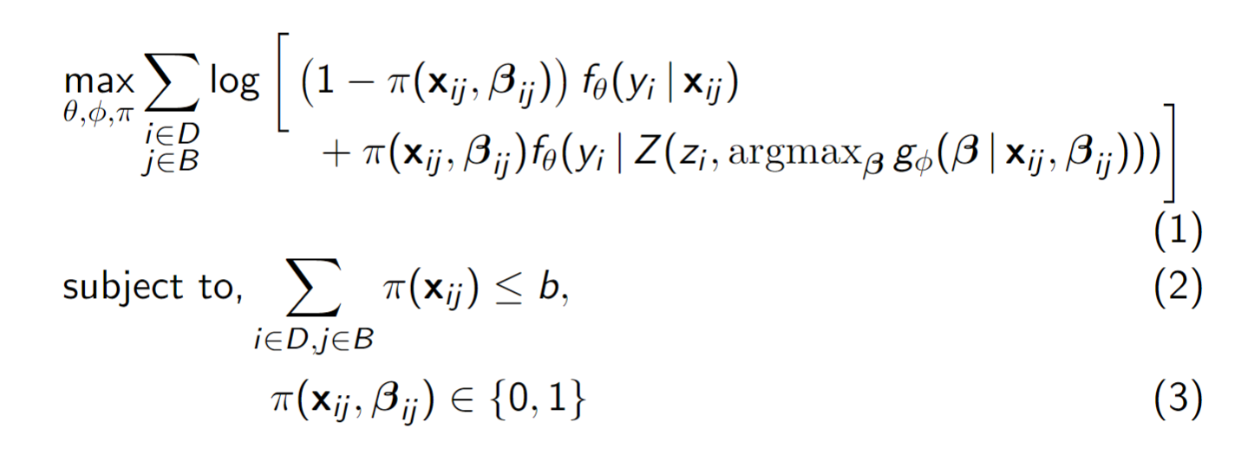
Recourse Objective

Slide 21
Recourse-aware Classifier
Classifier need not produce accurate predictions for $x_{ij}$ if $π\left(x_{ij}\right)=1$
For such instances, it needs to make accurate predictions on recoursed instance instead

Slide 22
Training $g_{φ}$
$g_{φ}$ always works with poor instances, and needs to predict a better setting.
A simple idea: In a group of $B_{i}$examples for the object i, why not make the least loss example the good one and bottom δ examples the bad ones?
What if all examples in $B_{i}$happened to be poor?

Slide 23
Idea
If $g_{φ}\left(x\right)=t^{′},$we want $f_{θ}\left(x^{′}\right)=y$
But to achieve that during training, we need $x^{′}∈D_{trn}$
What if it is not?
We cannot afford generating counterfactual $x′$
Instead we generate counterfactual accuracy achievable by the classifier $f$!
$f^{CF}\left(y^{∗}|x^{′}, t^{′}\right)=Accuracy(\{\left(x, t, y\right)∈D_{trn}|t=t^{′} \& y=y^{∗}\})$

Slide 24
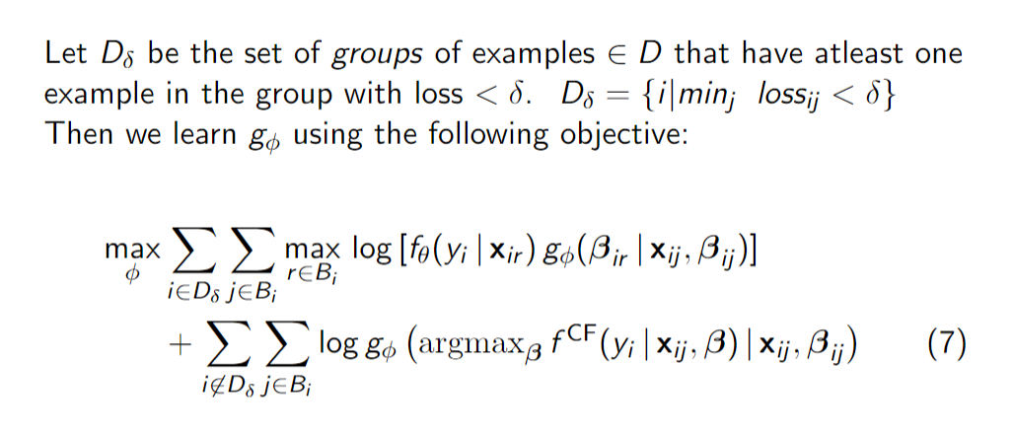
Objective

Slide 25
Learning $π$
A simple heuristic based approach works

Slide 26
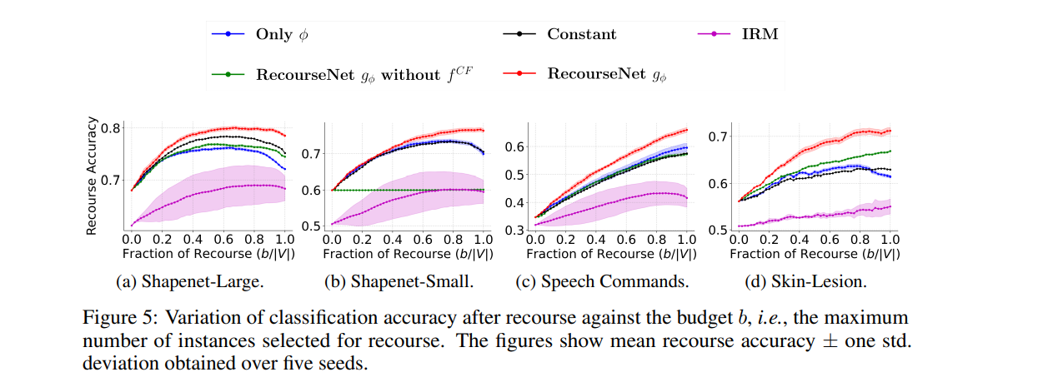
Results

Slide 27
Remainder of the Talk!
Can we model $f^{CF}$better?
It turns out that the answer lies in Conditional Average Treatment Effects / Individualized Treatment Effect

Slide 28
Treatment Effect Estimation
Suppose we want to decide which treatment is better for a certain kidney disease.
We have two alternatives: {Treatment A, Treatment B}
We have access to a dataset of about 700 individuals
350 received treatment A
350 received treatment B

Slide 29
 | Treatment A | Treatment B
% Cured | 78% (273/350) | 83% (289/350)
Can we conclude that B is better?

Slide 30
Let us zoom in Data
Stone size | Treatment A | Treatment B
Small stones | Group 1 93% (81/87) | Group 2 87% (234/270)
Large stones | Group 3 73% (192/263) | Group 4 69% (55/80)
Both | 78% (273/350) | 83% (289/350)

Slide 31
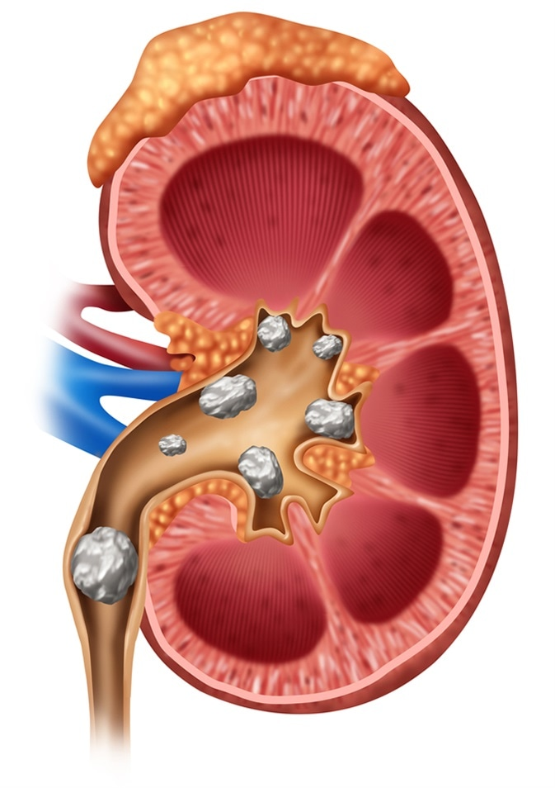
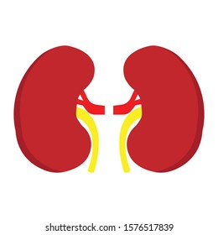
Causal Graph (Confounding Model)
Size of the Kidney stone is a confounder here
X
T
Y
Issue: There are variables that affect both the treatment assignment and outcomes

Slide 32
Problem Statement
Given an individual, assess the difference in outcome as a result of giving different treatments
Goal is to learn the outcome differences from observational dataset
For every individual we have supervision for only one outcome
Difference labels are missing
X | T | Y(T=A) | Y(T=B) | Y* = Y(T=B) – Y(T=A)
Small | A | Cured | ?? | ??
Large | B | ?? | Not Cured | ??
Large | B | ?? | Cured | ??
Small | B | ?? | Not Cured | ??

Slide 33
Individual Treatment Effect Estimation
Determine the effect of treatment at an individual level

Slide 34
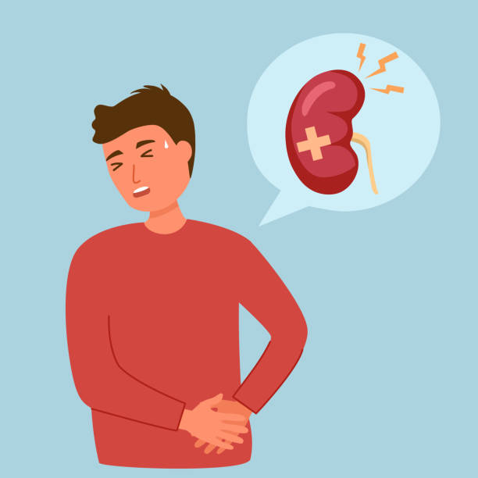
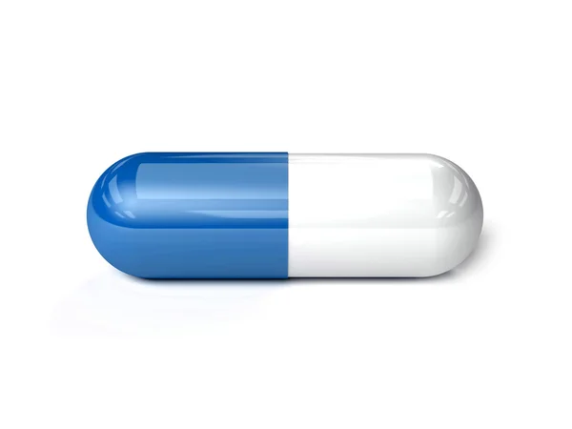
Selection Bias
Notes:
The main hurdle in resolving the dilemma from the training dataset is the presence os selection bias. In causal inference context we ofter refer to the training dataset as the observational dataset.
We say that the selection bias exists when the treatment assignment to patients happens in a biased manner. For example, we see I out context that easy patients with smaller stones were treated with red pill whereas challenging patients are treatned with the blue pill. Such selection bias is unavoidable in real life. Perhaps red pill is cheaper. Perhaps red pill has lesser side effects and is adequate to treat smaller stones.
The pounch line is that the real life observational datasets are going to be injected with selection bias and we as researchers must provide “in-principle” algorithms that reflect correct treatment effect estimates.
The variable such as size of the stone here are called as confounders.

Slide 35
Conditional Average Treatment Effect
Let us understand this assumption further!
Address confounding by conditioning on X (Size of the stone)
$$\text{Effect}\left[T|X\right]=E\left[Y | T=1, X\right]−E\left[Y | T=0, X\right]$$
The above estimate computed on observational datasets is valid under certain assumptions
Overlap: $P\left(T | X\right)>0$
Conditional Ignorability: $Y\left(0\right), Y\left(1\right)⊥T | X$

Slide 36
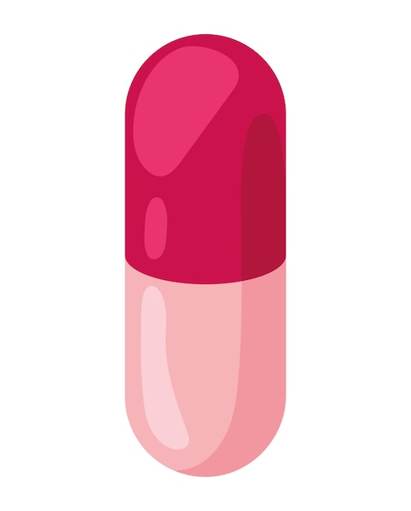
The treatment and control group within each stratum is exchangeable.
Stratum of Aged People
Treated
Control

Slide 37
Conditional Ignorability {Y(0),Y(1)} 丄 T | X
Within strata of $x$, treatment gives no information on the distribution of the potential outcomes.
Two observations with the same $x$ but different $T$ can be compared to estimate the causal effect as a difference of their outcomes.
What do we get with conditional Ignorability?
$$E\left[Y \right|do\left(T=1\right), x]=E[Y\left|do\left(T=1\right), T=1, x\right] \left(as T⊥Y\left(1\right)\right|x) \\ →E\left[Y | do\left(T=1\right), x\right]=E[Y|T=1, x]$$
$$U_{T}$$
X
T
Y
Any unobserved variable that affects T does not affect the potential outcome
Notes:
Either we must know the

Slide 38
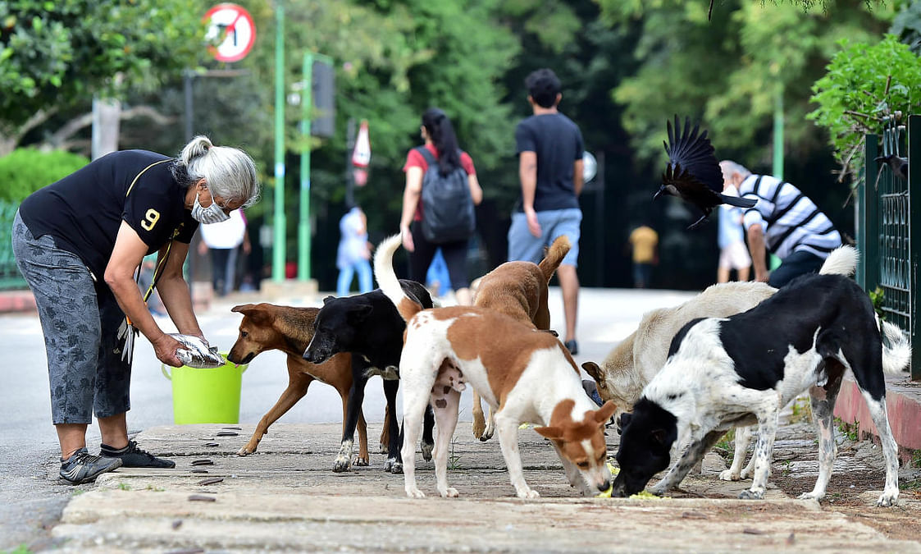

Slide 39
Space of CATE for binary treatments was too crowded and so we focused on continuous treatments.

Slide 40
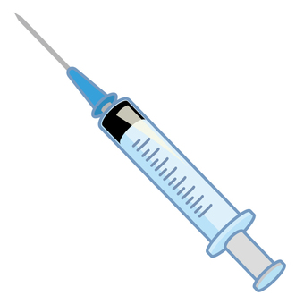
Continuous Treatments?
We deal with continuous treatments, which exacerbates the problem even more.
Notes:
We deal with treatment effect estimation with a twist that our treatment variable is not binary, but can take on a range of continuous values.
This adds a layer of complexity to an already intricate problem, requiring us to come up with novel estimation strategies.

Slide 41
Recipe to Treatment Effect Estimation
Predict $y=f_{θ}\left(x, t\right)$ $$\text{Effect}\left(T | x\right)=f\left(x, 1\right)−f(x,0)$$

Slide 42
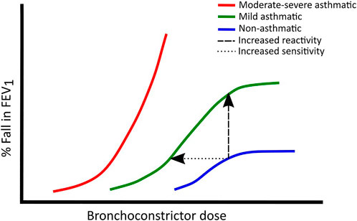
One additional assumption
We assume that the response (y) is differentiable w.r.t.the dosage of treatment T
Images borrowed from google search
Notes:
Before getting into our approach There's another assumption we make, and it is especially relevant to continuous treatments.
We assume that the response (y) is differentiable with respect to the dosage of treatment (T). This essentially means that small changes in the dosage of the treatment result in small changes in the outcome. While this assumption may seem technical, it often holds true in practice.
To illustrate this assumption, I've included dose-response curves obtained from Google Images. I do not know the specifics of these experiments, but this should hopefully convince you that the extra assumption we're making here is quite mild. Now, let's explore how this assumption aids us in our solution.

Slide 43
Our Approach – GIKS
AAAI-24
GIKS – Gradient Interpolation and Kernel Smoothing
Our main idea:
Reduce confounding using data augmentation
For each sample $\left(x, t, y\right)∈$ observational data
Sample new $t^{′}$
Hallucinate outcome $\hat{y}\left(x, t^{′}\right)$
Add $\left(x, t′,\hat{y}\left(x, t^{′}\right)\right)$ to observational data
Notes:
Now we present our approach GIKS that is short for Gradient Interpolation and Kernel Smoothing
Our main idea is data augmentation
For each observed sample, we sample many new treatments and augment it with hallucinated outcomes.
Indeed, you guessed right the two terms in the title denote two methods of how we obtain the hallucinated outcomes.

Slide 44
Augmenting new treatments for $\left(x, t, y\right)$
For $\left(x, t, y\right)$ and a new $t′$
If $\left|t −t^{′}\right|<δ$, obtain $\hat{y}\left(x, t^{′}\right)$ using gradient interpolation
If $\left|t −t^{′}\right|>δ$, obtain $\hat{y}\left(x, t^{′}\right)$ using kernel smoothing (Gaussian Process)
Notes:
Which strategy we use for hallucinating outcomes that are in turn augmented in the observational dataset depends on the proximity between the new treatment t’ and the observed treatment t.
Particularly, if t’ is near t, we use gradient interpolation strategy
If it is far, we obtain the outcome using kernel Gaussian process.
Next we delve into why we need two different strategies

Slide 45
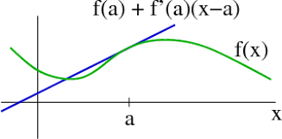
Gradient Interpolation
Since the response function is differentiable, we can obtain $\hat{y}\left(x, t^{′}\right)$ using a first order Taylor’s expansion for $t^{′}$ that is close to $t$
$y\left(x, t^{′}\right)=y\left(x, t\right) −\left(t −t^{′}\right)\frac{∂η(φ\left(x\right), t)}{∂t }$
GI Loss = $\sum{L(η\left(φ\left(x\right), t^{′}\right), y(x, t^{′}))}$
Notes:
Given our assumption that the response curve is differentiable, we can utilize Taylor's expansion. In particular, for treatments that are close enough, a first-order Taylor expansion provides us with reasonable pseudo-outcomes that can be incorporated into the dataset.
With the samples augmented in this manner, we can then apply conventional loss functions to them.
Well what difference does it make? Let us look at what happens with the GI Loss

Slide 46
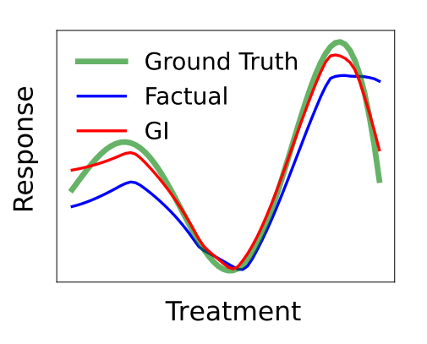
Predicted Response curve with GI Loss
In the observational dataset, it so happened that the likelihood of observing lower dosages was very loss and so factual baseline suffers
Notes:
Here I am showing the ground truth response surface in green.
The blue curve represents a factual model trained solely on the observational dataset without augmentation.
The red curve illustrates the response curve obtained through Gradient Interpolation (GI) augmentation for treatments close to those observed.
I like to draw your attention to the lower dosage region where we clearly observe the merits of GI loss. It so happened in this dataset that lower dosages received lesser support and thus we see that data augmentation helps. Moreover we observed that GI loss exhibits a strong smoothness inductive bias on the predicted response curve.

Slide 47
Kernel smoothing
If $t^{′}$ is far from $t,$then first order Taylor’s expansion fails
Moreover, hallucinated outcomes for far away treatments can be unreliable
We capture uncertainty through a Gaussian Process
Then we impose uncertainty aware loss using the hallucinated outcomes
Notes:
When 𝑡′ is significantly distant from 𝑡, the first-order Taylor's expansion breaks down.
Moreover, hallkucinating outcomes for such t’ may be challenging and can be wrong.
Therefore it is imperative to augment “uncertainty-aware” pseudo outcomes
Then we process these uncertainty estimates to tone down the impact of wrong pseudo-outcomes.
We this using Gaussian Processes.

Slide 48
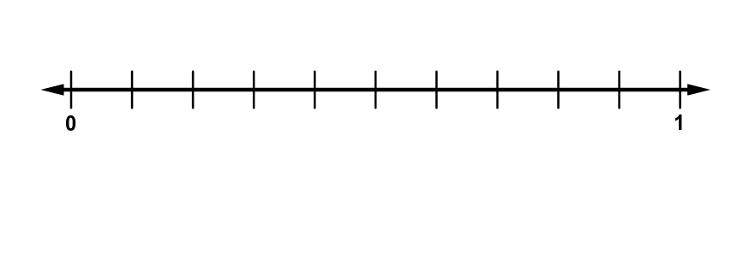
t
$$t′$$
$$y(x, t)$$
$$x$$
Goal: Hallucinate
$$\hat{y}(x, t′)$$
as well as capture $σ^{2}[\hat{y}\left(x, t^{′}\right)]$
Step 1: Collect all instances from training whose observed treatments are close to $t′$
$$D_{NN}\left(t^{′}\right)=\left\{\left(x_{i}, t_{i}, y_{i}\right)∈D_{obs} \right| \left|t_{i} −t^{′}\right|<ε\}$$
Step 2: Fit a Gaussian Process on $D_{NN}\left(t^{′}\right)$
Then infer $\hat{y}(x, t′)$ as posterior mean, variance $GP\left(∙\right|D_{NN}\left(t^{′}\right), x)$
Notes:
Now consider a patient x for which we have label available for the brown treatment t
Our goal is to hallucinate the outcome y(x, t’) for the blue treatment t’. As you can see that t’ is fat from t, we need to capture the variance associated with the hallucination to control for unreliable augmentations. We precisely achieve this with a Gaussian Process.
This is the only involved slide in my entire talk and requires some familiarity with Gaussian Processes. Far treatment augmentation is a 2-step process.
First we collect the dataset DNN that comprises training instances whose observed treatments happen to be close to t’
Then we obtain the hallucinated y as posterior predictions from a GP trained on DNN.

Slide 49
KS Loss
Interesting part is how we process the variance estimates from the GP
This is SoftMax over the negative variances
Essentially we downplay the loss contributions corresponding to the hallucinated outcomes with large uncertainty
Notes:
Here I am showing the method in which we tone down the unreliable augmentations.
Sigma^2 term highlighted here shows the variance of GP predictions. If variance is large, uncertainty is more
So we apply a softmax over the negative variance and then scale the losses accordingly.
This helps us downplaying the losses corresponding to less reliable augmented samples.

Slide 50
Results
Notes:
Let us get into results.
We compared with many SOTA baselines for cont treatment effect estimation on counterfactual prediction error. We consistently observed that GIKS beats other baselines. A close competitor was VCNet with HSIC regularizer. HSIC is Hilbert Schmidt Independence criterion a Kernel based independence assessment test.
It is worth mentioning that HSIC is designed for CATE where as other approaches that predominantly use the so called targeted regularizer are better suited for estimating average treatment effects.

Slide 51
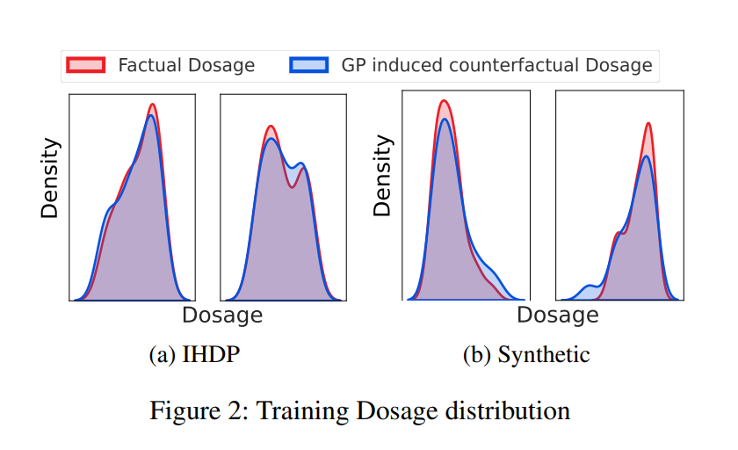
Impact of augmented Treatments
Notes:
Here I am showing the treatment distribution after GIKS augmentations. We see that GIKS reduces the skew in treatments and thereby achieves better performance.

Slide 52
Conclusion
We addressed estimating Individualized Continuous Treatment Effects by augmenting observational dataset with hallucinated outcomes for new treatments.
We devised two strategies for synthesizing pseudo targets.
Experiments on benchmark ICTE datasets showed statistically significant gains over other baselines.
In future, we would like to precisely characterize the cases under which GIKS is more likely to perform better than the factual model.

Slide 53
But is Data Augmentation a good strategy?
Sensitive to Hyperparameters
Deciding GI regime vs. GP regime
Kernel Hyperparameters
We took a step back, and thought even for binary treatments, there is a lot of gap to fill
Many, if not most, methods in literature are also too sensitive to hyperparameters

Slide 54
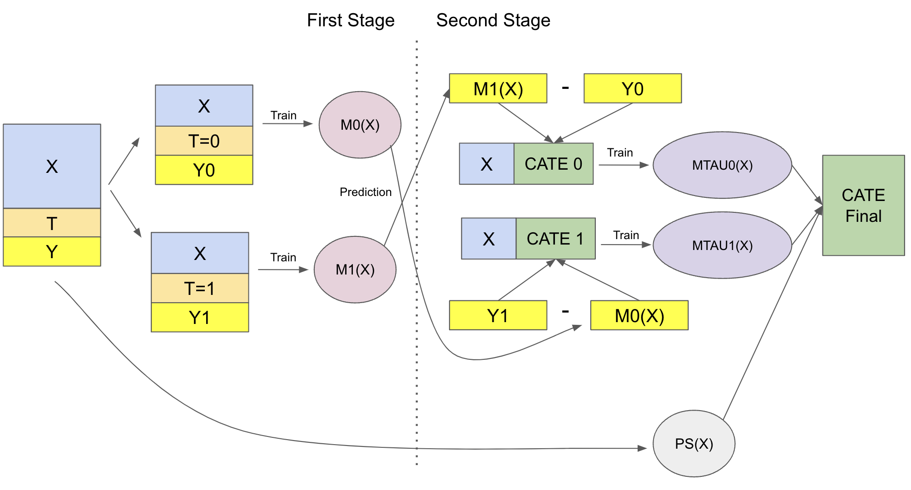
Recipe 1: Meta Learners
Second stage fits on predictions from the first stage.
Errors are cascaded across the two stages rendering $τ$ suboptimal.
$$L\left(x, t, y\right)={\left[y −\hat{y}\left(x, t\right)\right]}^{2}$$
$$L\left(x, t, y, \hat{y}(x, 1−t)\right)={\left[\left(y−\hat{y}\right)−τ(x)\right]}^{2}$$
https://matheusfacure.github.io/python-causality-handbook/21-Meta-Learners.html

Slide 55
Recipe 2: Representation Learners
IPM can be:
Wasserstein distance
MMD
HSIC
Etc.
https://medium.com/mlearning-ai/quick-introduction-to-counterfactual-regression-cfr-382521eaef21

Slide 56
Recipe 3: Matching Methods
+ Counterfactual Losses
https://builtin.com/data-science/propensity-score-matching

Slide 57
Our Recipe: PairNet
ICML-24
+ Factual Losses
https://builtin.com/data-science/propensity-score-matching

Slide 58
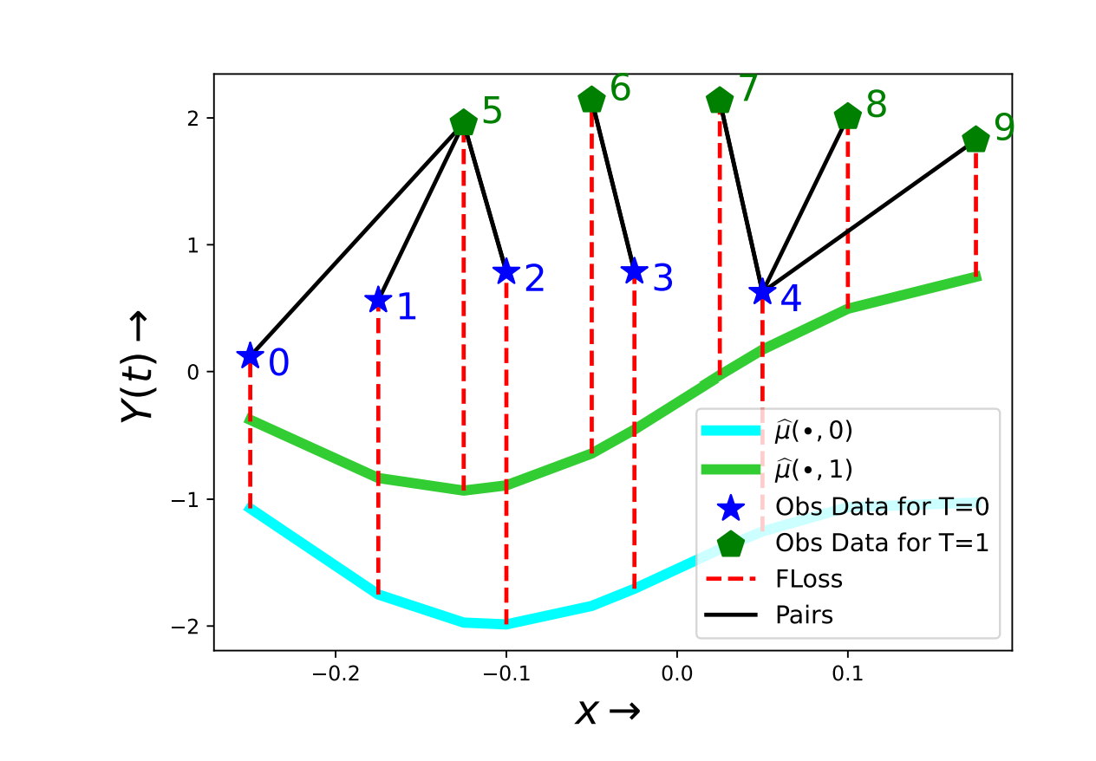
PairNet is very Simple
Factual Loss
$$𝓛_{F}\left(4\right)={\left[y_{4}−\hat{y(x_{4}, t )}\right]}^{2}$$
Matching Loss
$$𝓛_{M}\left(4, 7\right)={\left[{\left(y_{4}−\hat{y\left(x_{4}, t\right)}\right)}^{2}+{\left(y_{7}−\hat{y\left(x_{4}, 1−t\right)}\right)}^{2}\right]}^{}$$
Pair Loss
$$𝓛_{P}\left(4, 7\right)={\left[\left(y_{4}−y_{7}\right)−\left(\hat{y(x,_{4} t)}−\hat{y(x_{7}, 1−t)}\right)\right]}^{2}$$

Slide 59
PairNet Loss

Slide 60
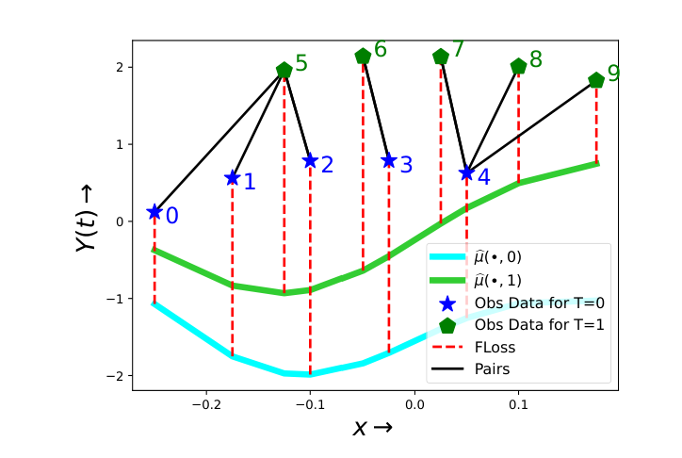
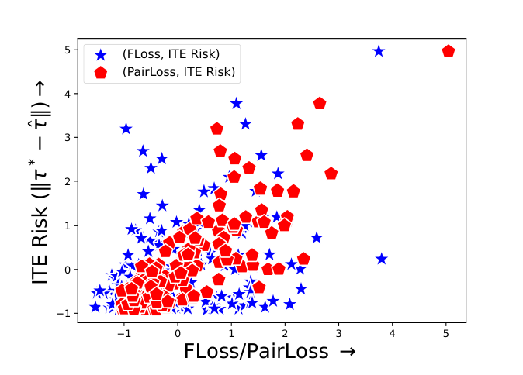
Why should PairNet work?
We sampled many such functions and computed the following:
ITE Error
Factual Loss
Pair Loss
PairNet Loss is more correlated with the ITE Error.
Corr of ITE error with | Factual | Pair | Pair w/o residue
 | 0.32 | 0.82 | 0.45

Slide 61
Why PairNet works in Theory
We compare generalization error of PairNet with Factual Model
Our test error is based on ITE labels
$$ε_{ite}={\left[\left(y\left(x, 1\right)−y\left(x, 0\right)\right)−\left(\hat{y\left(x, 1\right)} −\hat{y\left(x, 0\right)}\right)\right]}^{2}$$
Absence of ITE labels precludes models from directly minimizing it.
Factual $ε_{F},$Pair Loss $ε_{pair}$minimizes ITE error if their losses are close to $ε_{ite}$
We bound the gap and show that PairNet has significantly lesser gap

Slide 62
Why PairNet works in Theory?
Pair Loss
ITE Error
Factual Loss
$${ε_{pair}= \left[\left(y\left(x, t\right)−y\left(x_{nbr} 1−t\right)\right)−\left(\hat{y\left(x, t\right)} −\hat{y\left(x_{nbr} ,t\right)}\right)\right]}^{2}$$
$${ε_{ite}= \left[\left(y\left(x, 1\right)−y\left(x, 0\right)\right)−\left(\hat{y\left(x, 1\right)} −\hat{y\left(x, 0\right)}\right)\right]}^{2}$$
$$ε_{F}^{t}={\left[y\left(x, t\right)−\hat{y\left(x, t\right)}\right]}^{2}$$
$$ε_{F}=ε_{F}^{1}+ε_{F}^{0}$$
For a given $\left(x, t, y\right)∈D,$we sample the pair $\left(x^{′}, 1−t, y^{′}\right)∈D$ following $q_{t}\left(∙ | x\right)$ distribution
$$q_{t}\left(x^{′} | x\right)∝e^{−{\left|\left|x −x^{′}\right|\right|}^{2}}p_{1−t}(x′)$$
$q_{t}$ is the induced neighbor distribution
$$u_{t}=P(T=t)$$
$p_{t}$ is the marginal $P(X|t)$
$K_{t}$ are Lipschitz constants of Error residue
PairNet assumes E$[{\left|\left|x_{nbr}−x\right|\right|}^{2}≤δ]$

Slide 63
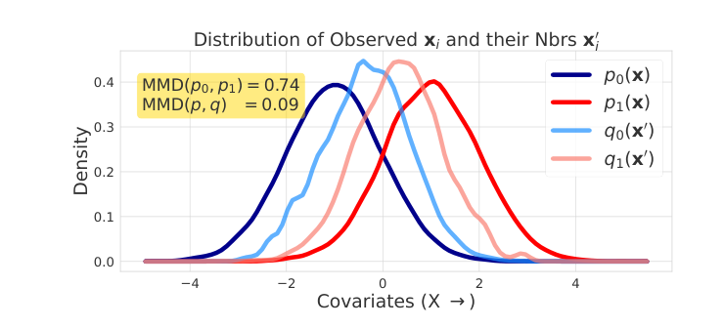
On the IPM terms

Slide 64
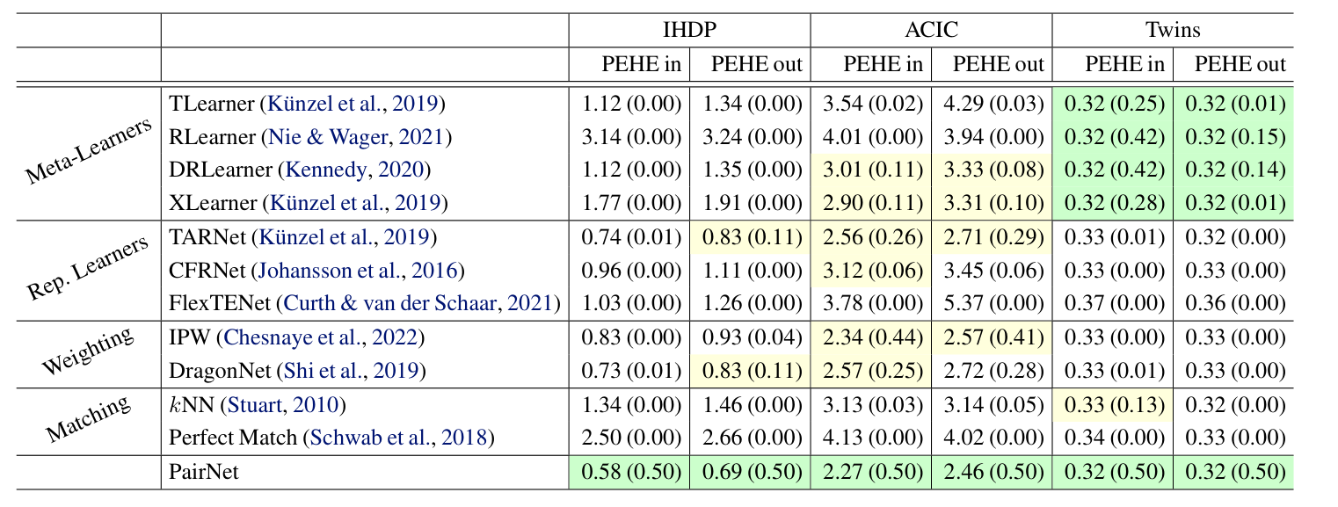
Does PairNet beat baselines

Slide 65
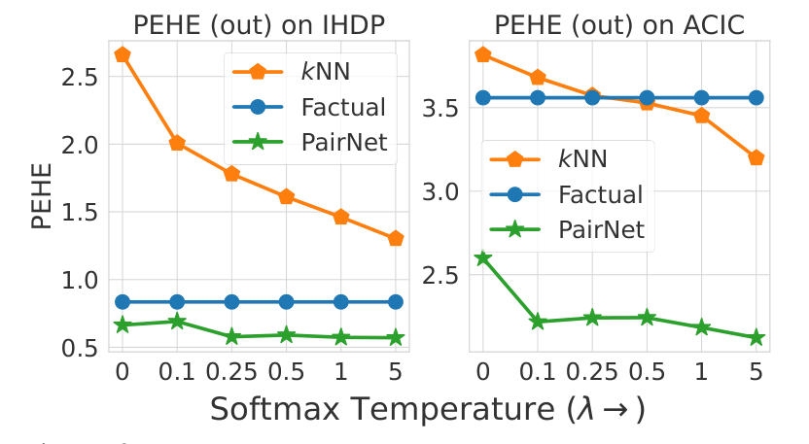
Are Pairs Important?
$$q_{t}\left(x^{′} | x\right)∝e^{−λ{\left|\left|x −x^{′}\right|\right|}^{2}}p_{1−t}(x′)$$

Slide 66
Conclusion
We proposed PairNet that is:
Model-agnostic
Applicable to diverse treatment domains
Robust to its hyperparameters
Easy to Implement
Consistent estimate for ITE
Offers better generalization guarantees
Works very well in practice

Slide 67
Back to Recourse
T
X
Y
Z

Slide 68
But this time, without counterfactuals in training dataset

Slide 69
But we could not solve under this setting
Ball is in Adobe’s court!
Dataset Interfaces: Diagnosing Model Failures Using Controllable Counterfactual Generation
https://arxiv.org/abs/2302.07865

Slide 70
Great at macro-edits
Not so great in micro-edits
Always OOD!
Nor good enough for counterfactuals!

Slide 71
Setting we assumed!
Under Submission in Neurips
X
T
Z
Y

Slide 72
Conclusion
Training models for flawless predictions is unrealistic.
Models must learn to abstain when unsure.
Calibration is the holy grail – often not possible with MLE based training.
When they abstain, ask human to generate a better instance.
Our proposal: Triage. Use human guidance to enhance model predictions by accurately estimating better settings. These settings can be predicted by better modelling of treatment effects. Achieving this is much easier than obtaining counterfactuals.
Although interventions are adequate to gauge better settings, counterfactual testing is inevitable.

Slide 73
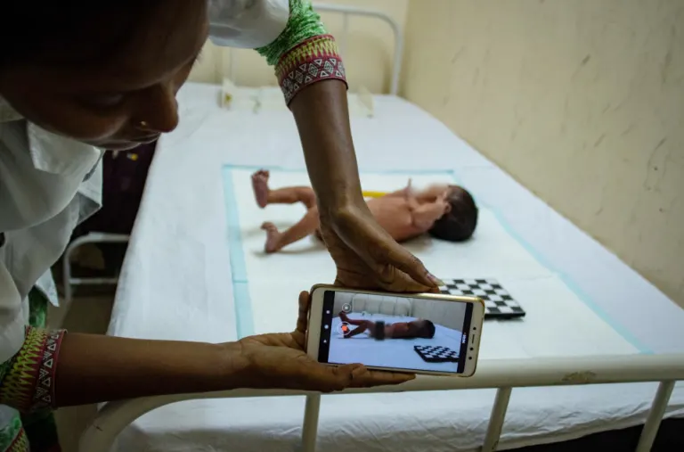
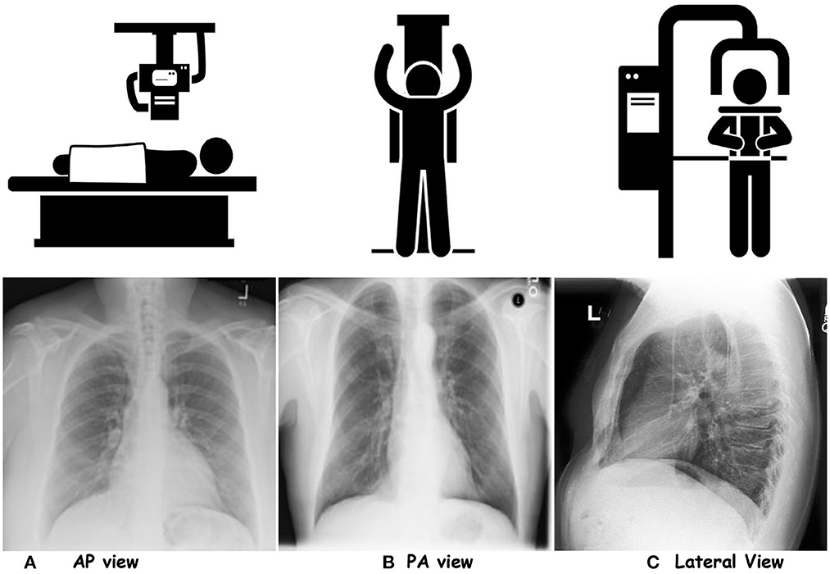
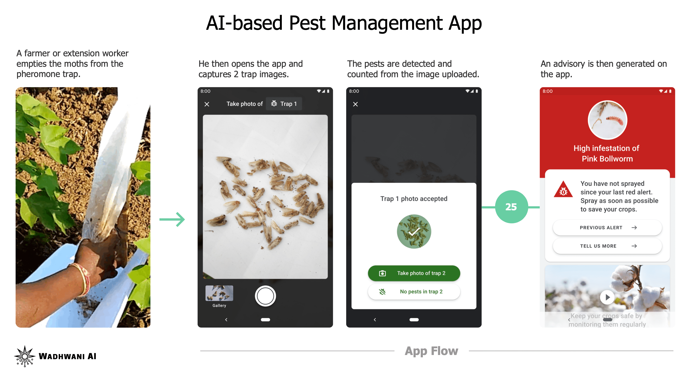
Punchline – Do not generate counterfactuals -- leverage humans.
Predict better counterfactual settings for a better aid.
https://www.wadhwaniai.org/

Slide 74
Thank You!

