Slide 1
HOBIT: Hardness Optimized Batch Sampling for InfoNCE Training
Lokesh N
Senior Researcher
Microsoft Research India
Email: lnagalapatti@microsoft.com
Accepted as a Spotlight at ICML 26
Joint work with Himanshu Dutta and Yashoteja Prabhu
Notes:
Good morning. Thank you so much for attending. I will discuss HOBIT a method we developed to enhance the infonce loss based training of dual encoders. HOBIT is accepted as a spotlight at ICML which we will be presenting next month. This is joint work with Yash and Himanshu, both from MSR India.

Slide 2
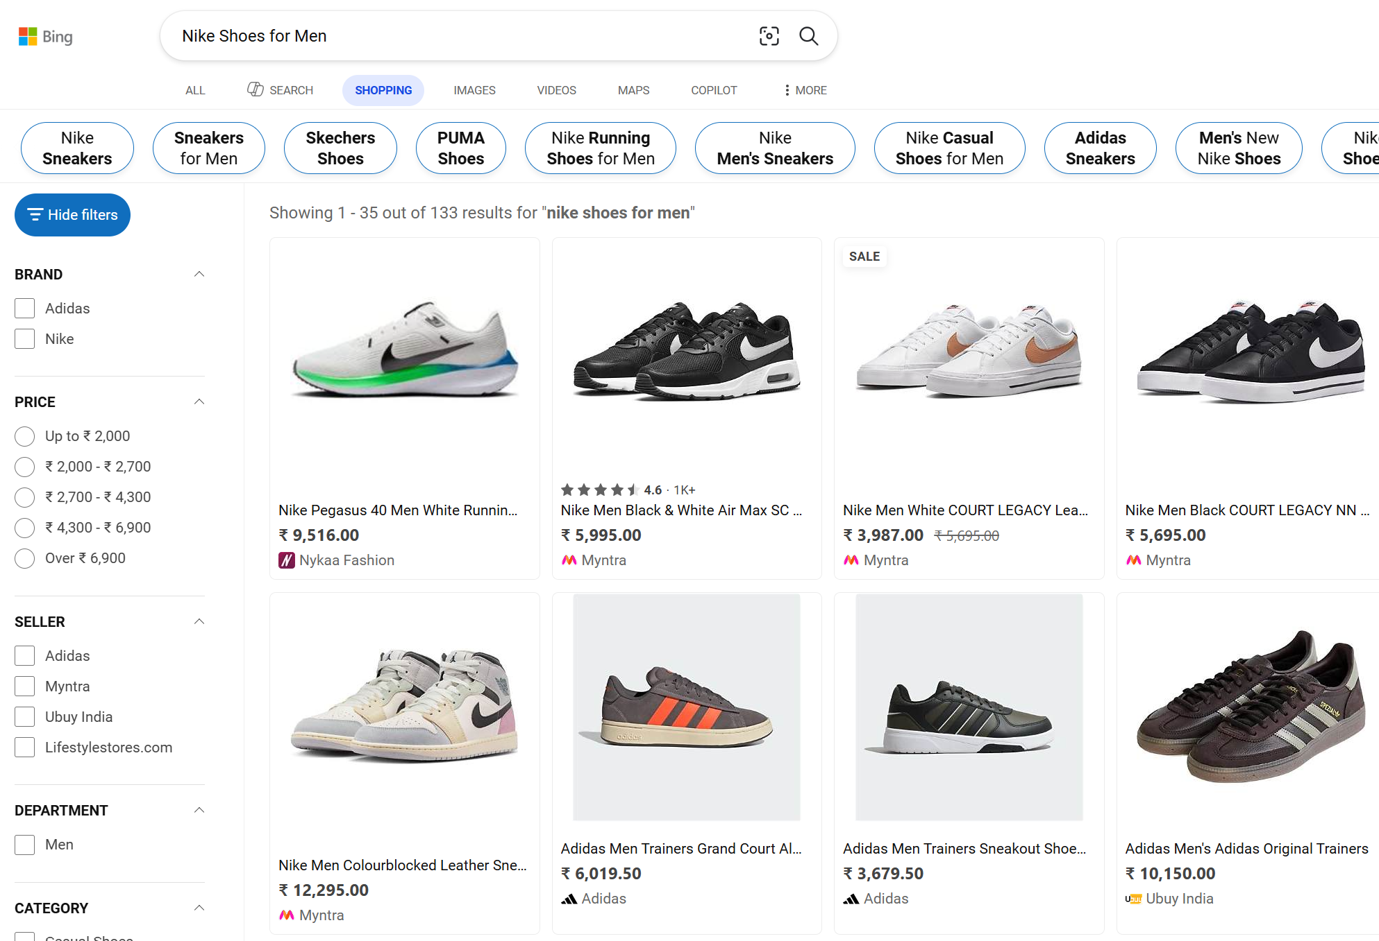

Bing Ads
Search Query (q)
+ve docs $d_{1}^{+}, …, d_{m}^{+}$
Credits: https://ads.microsoft.com/
Notes:
Let us consider Bing Ads application as an example.
A user might type in a search query q, for which the ml machinery in the background fetches the relevant advertisements. In this talk, we refer to such ads as positive documents.

Slide 3

Corpus
Notes:
This is a very complicated Information Retrieval problem because in production, the positive docs must be fetched from a huge corpus that comprises billions of documents collected from a very diverse set of domains such as ecommerce, travel, etc.
This corpus generally scales to billions of documents whereas the number of positive documents relevant for a query is typically a few thousands.

Slide 4
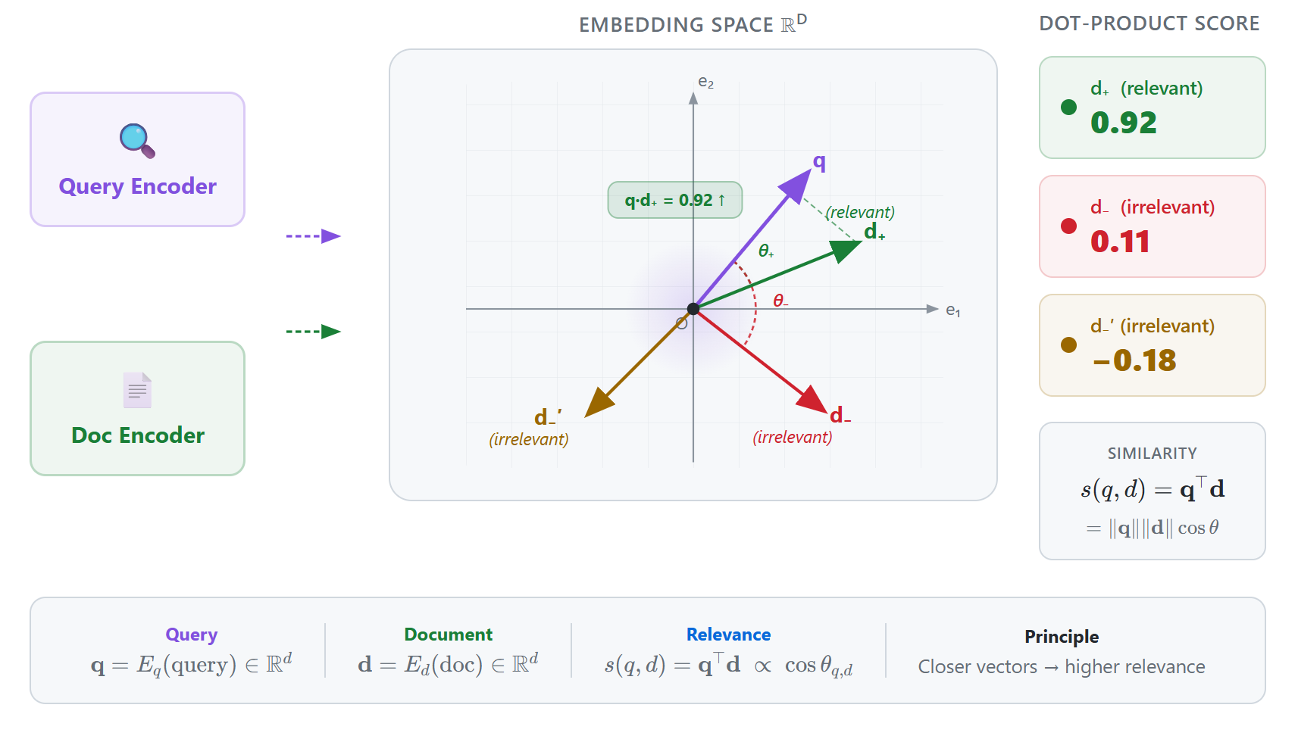
Embedding and Dot-Product Relevance
Notes:
This is what happens under the hood. We have an embedding model f that maps the query and document text into a d-dimensional vector space. We say that a document d is relevant for a query q when their similarity measured as a dot-product between the query and document embedding is high

Slide 5
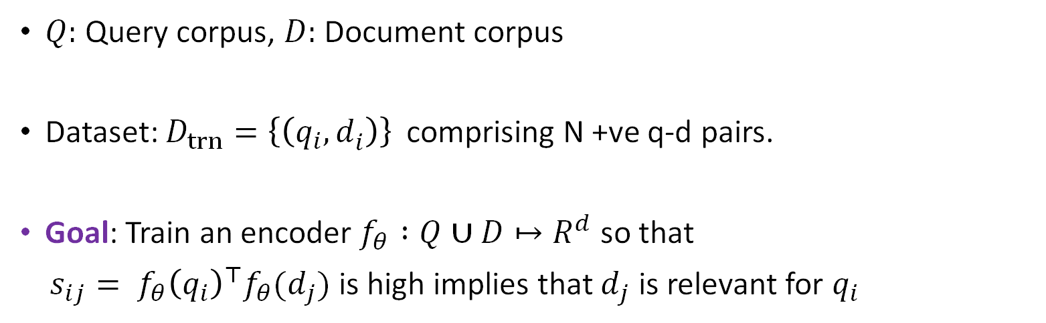
Training Dual Encoders
$Q:$Query corpus, $D:$ Document corpus
Dataset: $D_{trn}={\left\{\left(q_{i}, d_{i}^{ }\right)\right\} }_{ }$comprising N +ve q-d pairs.
Goal: Train an encoder $f_{θ} :Q∪D↦R^{d}$ so that
$s_{ij}= f_{θ}{\left(q_{i}\right)}^{⊤}f_{θ}(d_{j})$ is high implies that $d_{j}$ is relevant for $q_{i}$
Notes:
With that background in place, let's move on to the formal problem setup.
We start with a corpus consisting of a set of queries, (Q), and a set of documents, (D).
Our training data contains (N) query–document pairs, sampled from this corpus. In an ideal world, we would have relevance labels for every possible query–document combination; that is, for the entire Cartesian product (Q \times D). In practice, however, we only observe these (N) positive query–document pairs.
Our objective is to learn an encoder (f) using this training data. The goal for the encoder f is to emit similarity score, (s_{ij}), such that it is high when (d_j) is relevant to (q_i), and low otherwise.

Slide 6
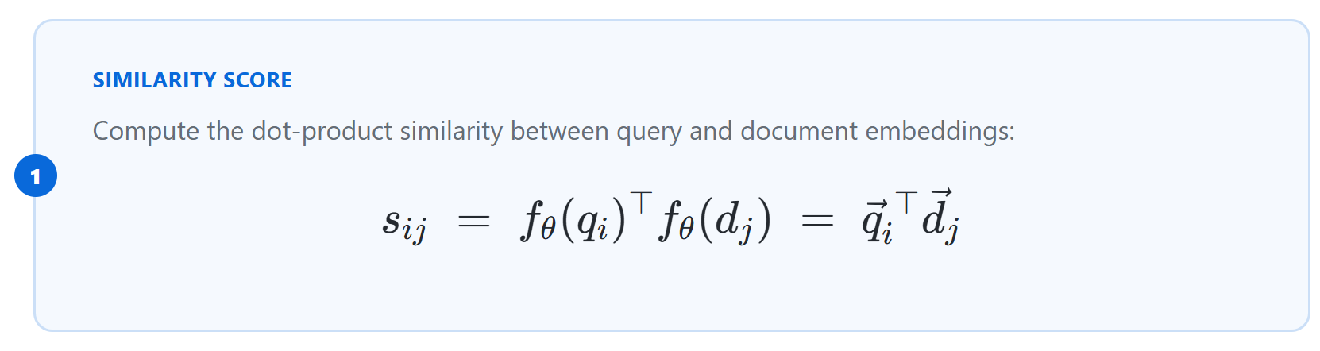
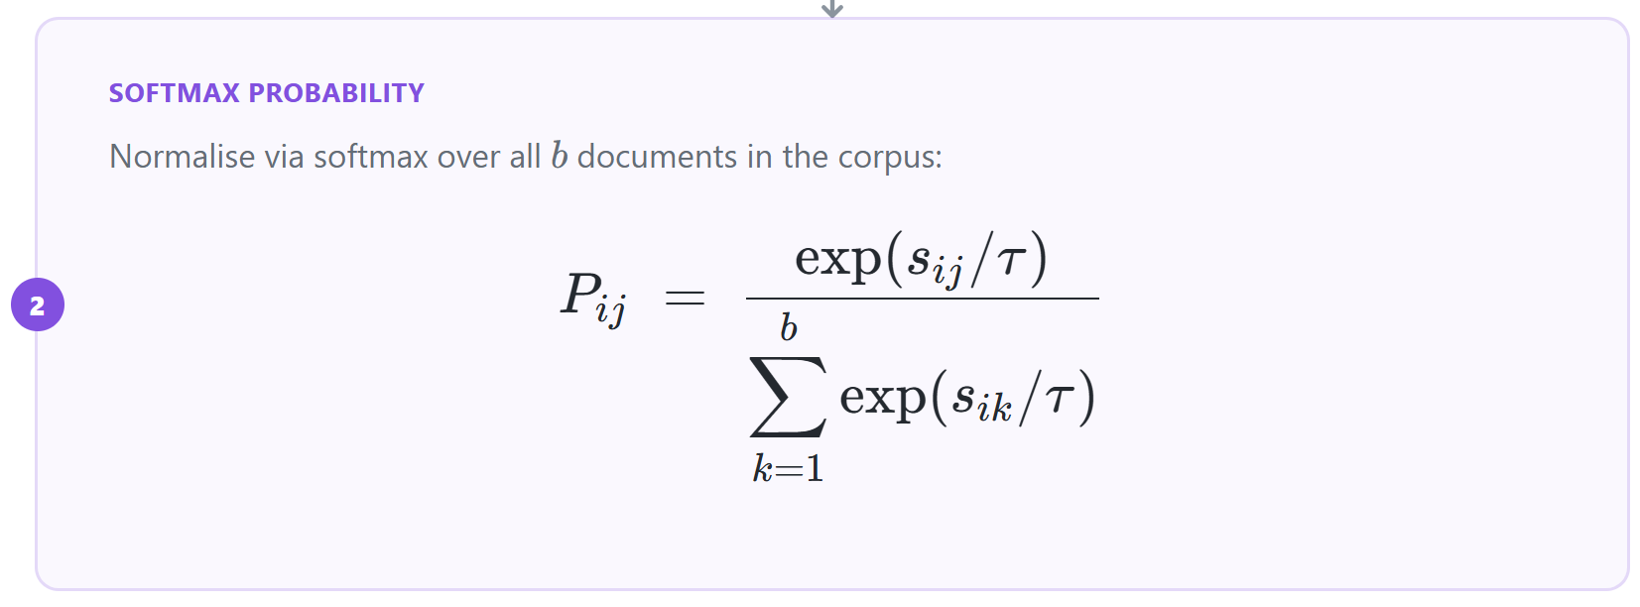
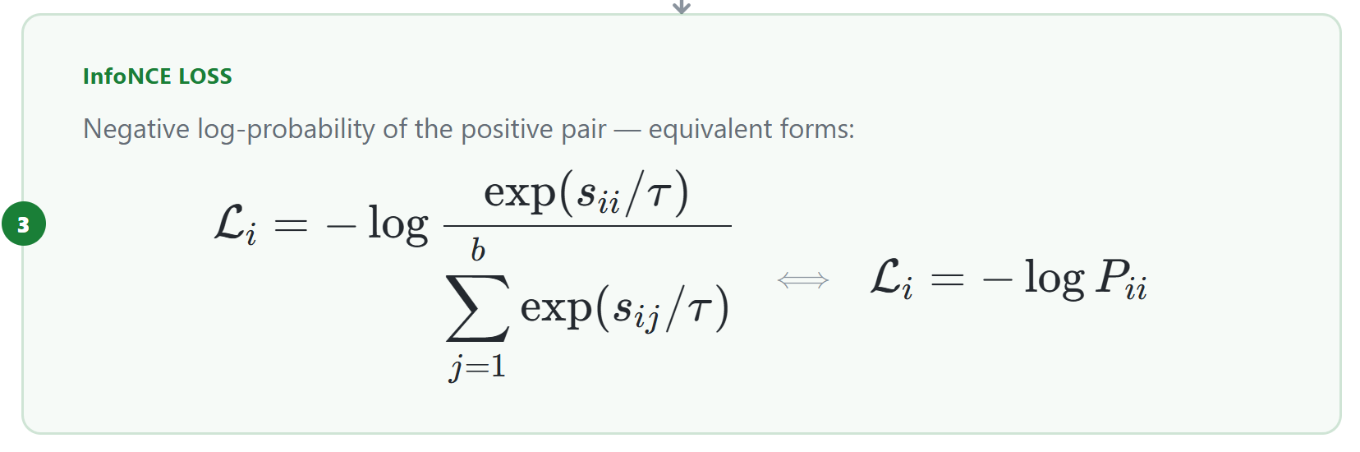


InfoNCE Loss for an item $(q_{i}, d_{i})$
Computing $P_{ij}$ is intractable.
Notes:
A very popular objective for training dense retrieval encoders is the InfoNCE loss.
InfoNCE converts similarity scores Sij into probabilities Pij via a softmax. Ideally, this softmax would normalize over the entire document corpus. However, that is computationally intractable at scale.
Therefore, in practice, we usually approximate the objective using in-batch negatives, where the denominator in the softmax is computed just using the documents in the mini-batch.

Slide 7
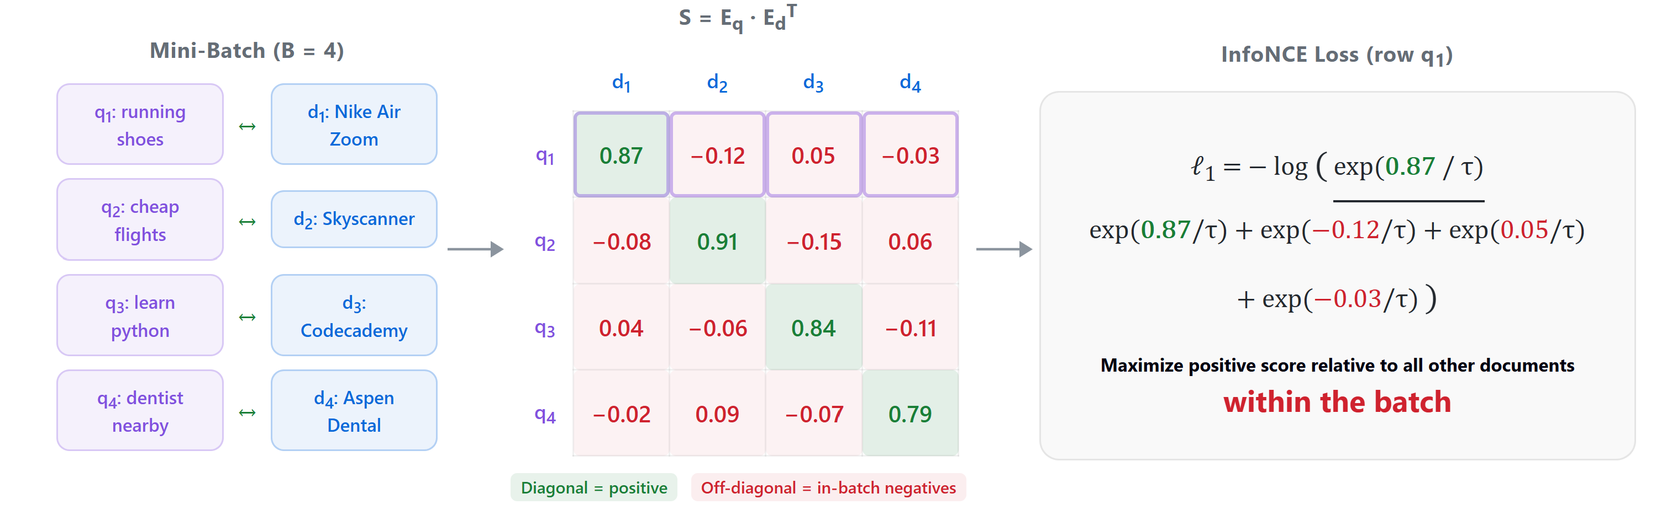
InfoNCE loss with in-batch negatives
Notes:
Let us understand this with a toy example.
Suppose we consider a batch size of 4. We have four q-d pairs.
For query q1 in the batch we compute its probability by applying softmax over just the four documents in the batch.

Slide 8
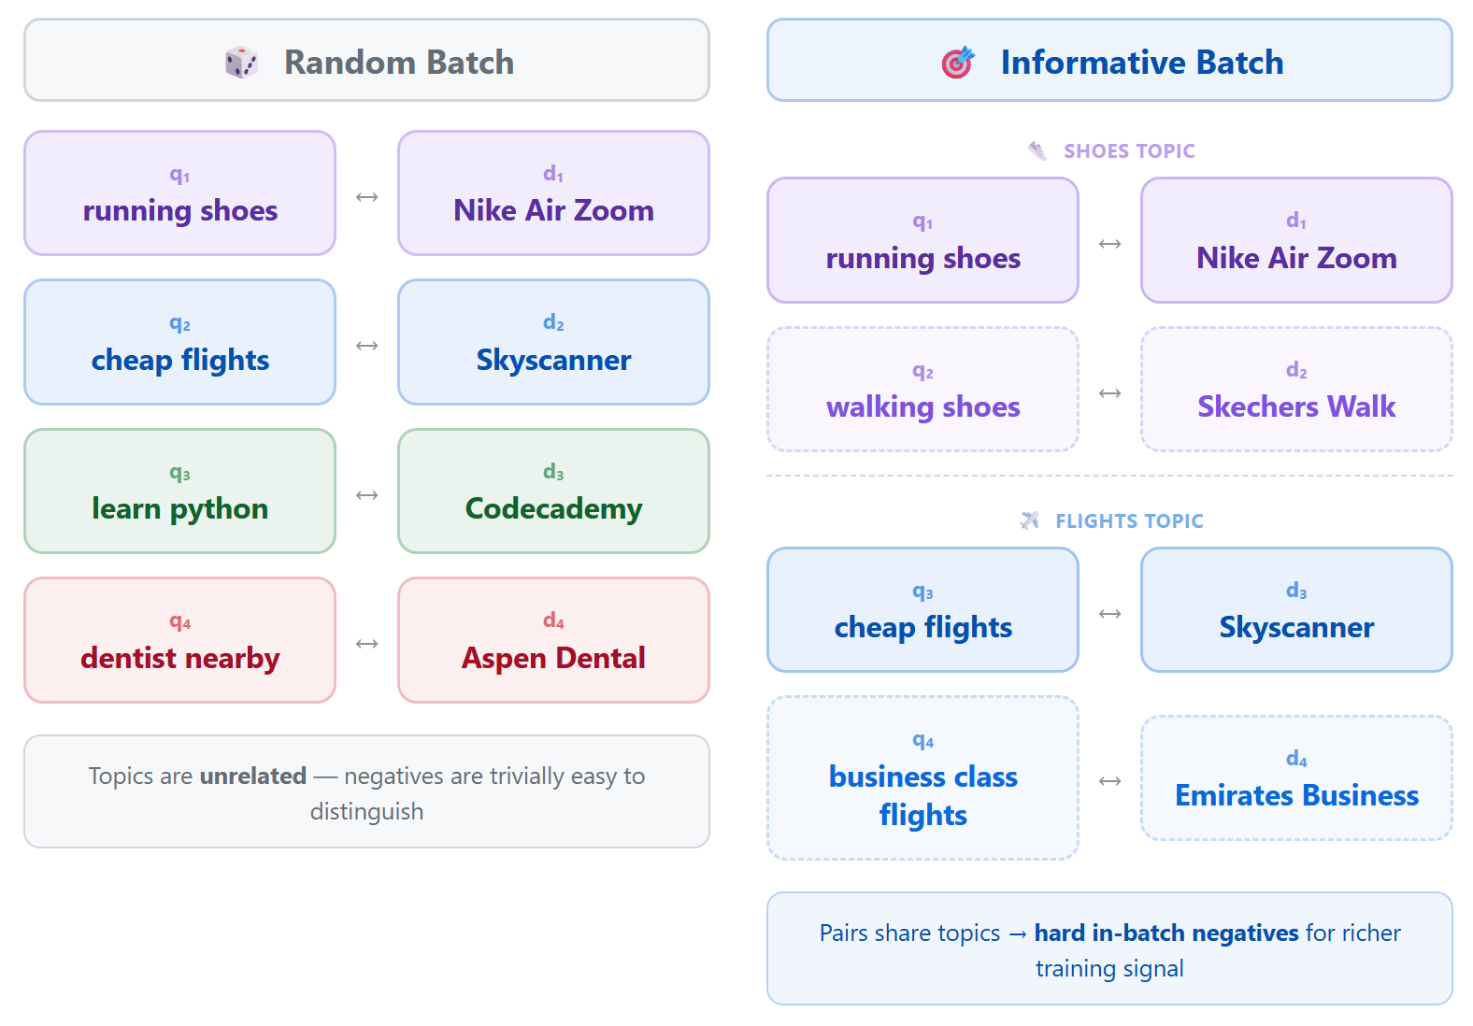
Random vs Informative Batch
Notes:
You might have already guessed the problem with the in-batch formulation.
Such a loss only works well when the batch contains informative hard negatives. If we sample batches randomly, most negatives are too easy, and the loss provides very little learning signal.
Take the query "running shoes" as an example. The negatives on the left are completely unrelated, so the model can easily separate them from the positive document.
On the other hand, a document like "Skechers walking shoes" is much harder to distinguish. These hard negatives force the model to learn finer semantic distinctions and therefore provide a much stronger training signal.

Slide 9
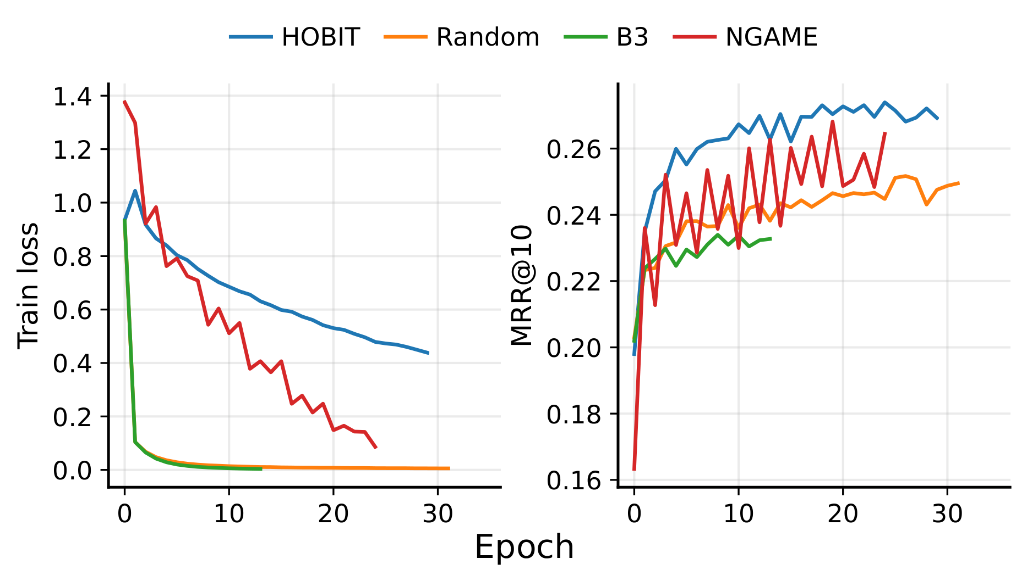
Need for Hard Negatives
Notes:
We also validated this hypothesis on the MSMARCO dataset.
The plot on the left shows training loss, and the one on the right shows test accuracy.
We can see that with random negatives, the training loss (in orange color) drops very quickly because the task is simply too easy. But that low loss does not translate into strong test performance.
HOBIT, on the other hand, maintains a substantially higher training loss because it exposes the model to harder negatives. Yet at test time, it outperforms random batching by a large margin.

Slide 10
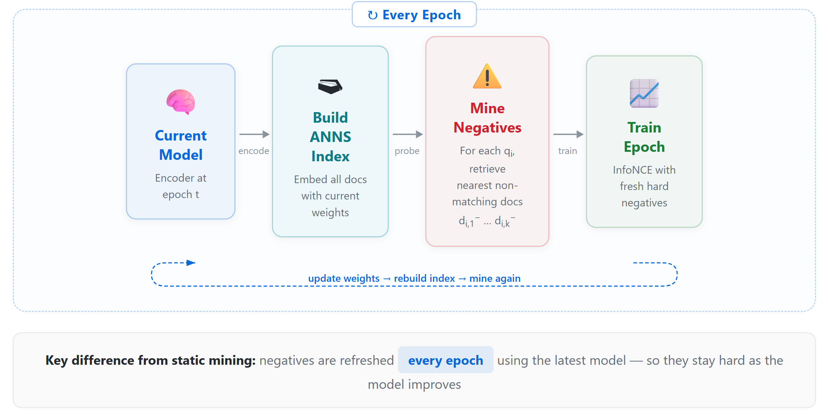
Hard Negative Mining (Online)
Notes:
Now that we understand the importance of hard negatives, prior methods such as ANCE solve this problem through explicit hard negative mining. They retrieve hard negatives for each query during training. However, this requires repeatedly building and refreshing a nearest-neighbor index over the entire document corpus, which becomes extremely expensive at production scale.

Slide 11
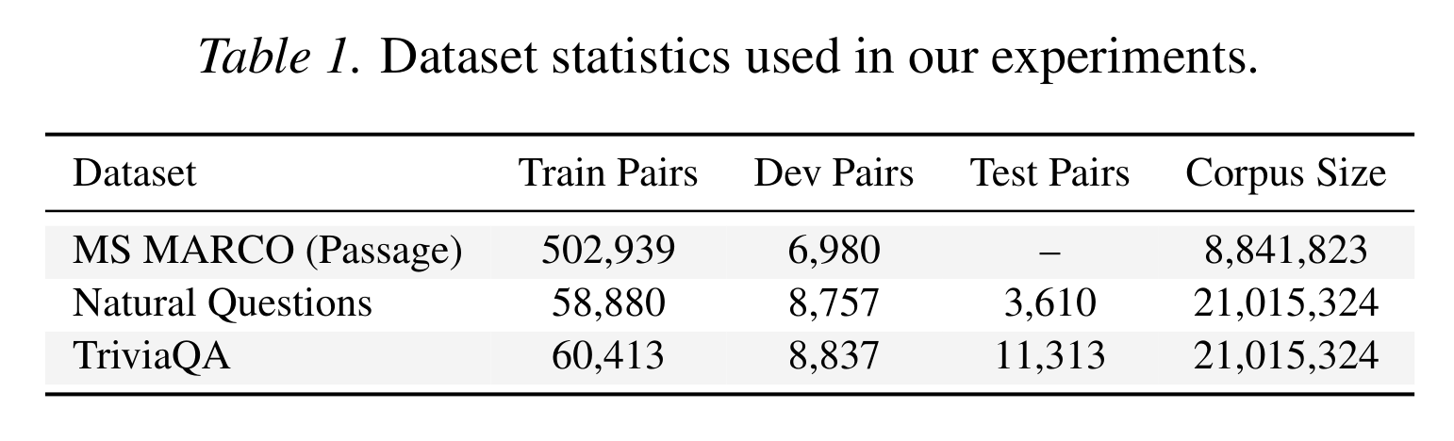
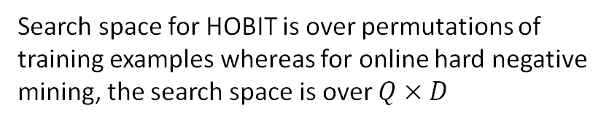
HOBIT: Smart Batching
We ask a simpler question: Can the batch itself be made informative?
Our Goal: A lightweight, principled batching strategy that constructs mini-batches where examples are hard negatives for one another.
Search space for HOBIT is over permutations of training examples whereas for online hard negative mining, the search space is over $Q×D$
Notes:
This brings us to our problem statement. Instead of obtaining hard negatives through explicit mining over an ANNS index, we focus on curating mini-batches that contain mutually informative examples.
Our goal is to develop a lightweight and principled strategy that permutes the training pairs such that the resulting mini-batches naturally provide hard negatives within the batch itself.
This is a much more tractable problem than ANCE. For example, if you consider the MSMARCO dataset, ANCE searches over the entire corpus of 8 million docs for hard negatives, whereas HOBIT’s optimization space is the set of all permutations of the 5 lakh training pairs.

Slide 12
Let us see what it takes to have sustained training across several epochs using InfoNCE Loss.

Slide 13
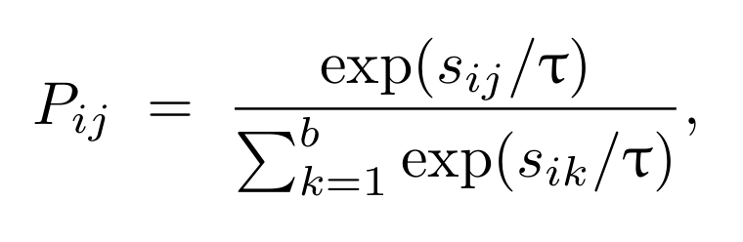
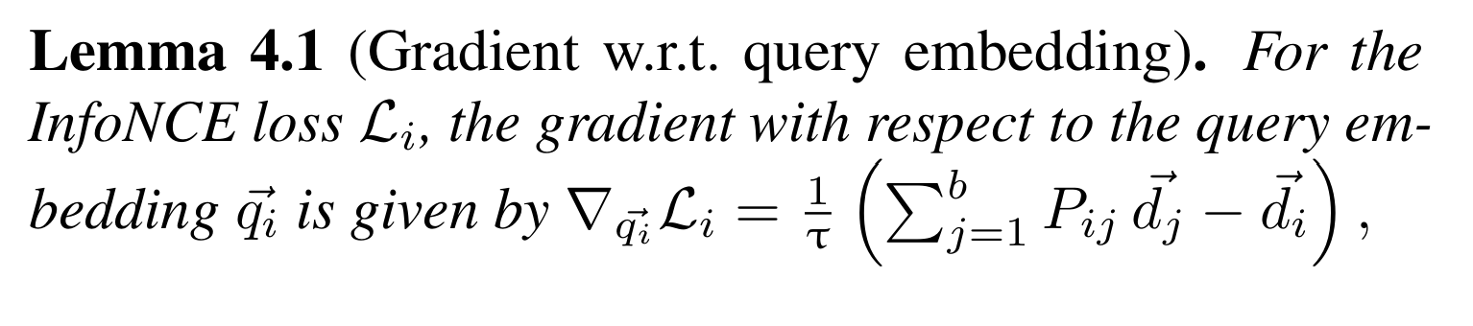
Why training collapses?
When $s_{ii}≫s_{ij}$ for all $j≠i$, the softmax collapses to $P_{ii}≈ 1$ and $P_{ij}≈0.$
Notes:
We start with a principled analysis of the InfoNCE gradient.
Now consider a batch containing only easy negatives. Since these negatives are easy to reject, their probabilities (P_{ij}) become very close to zero. Consequently, this weighted sum is dominated by the positive document (d_i), and the gradient approaches zero.
This is why random batching saturates so quickly, and the model receives almost no learning signal.

Slide 14
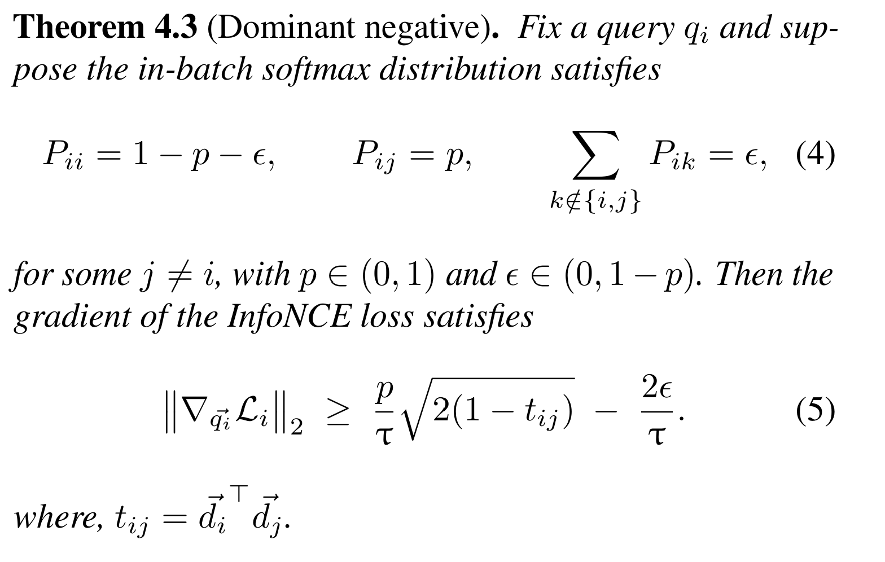
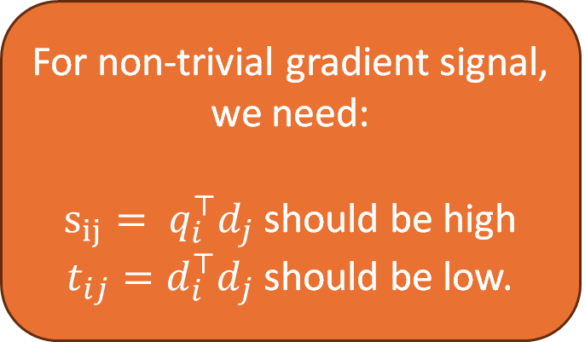
Dominant negative
For non-trivial gradient signal, we need:
$s_{ij}= q_{i}^{⊤}d_{j}$ should be high
$t_{ij}=d_{i}^{⊤}d_{j}$ should be low.
Notes:
Now let us see what happens when the batch contains at least one hard negative with non-zero probability (P_{ij}).
In this case, we can lower bound the gradient norm by the following term. The bound reveals two conditions that are necessary for maintaining a meaningful learning signal.
First, the negative document (d_j) should be hard, meaning that its similarity with the query is high.
Second, the negative document should be far away from the positive document. In other words, a good negative should challenge the query without interfering with the positive.
Both these conditions guarantee a sustained training signal over many epochs.

Slide 15
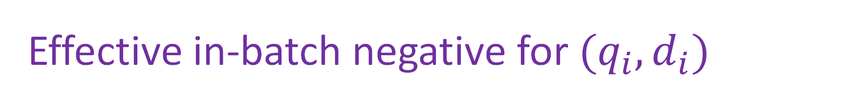
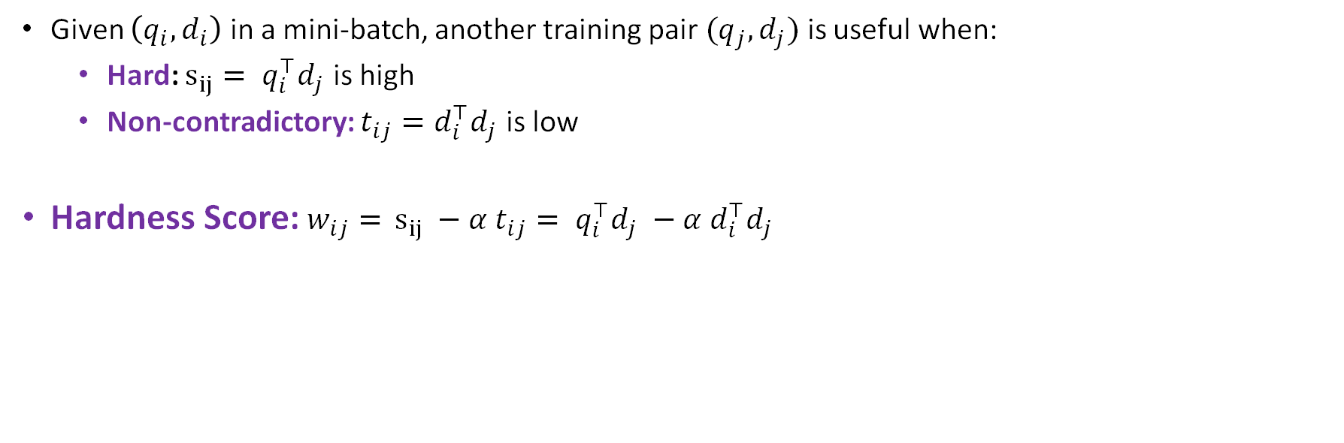
Effective in-batch negative for ${(q}_{i},d_{i})$
Given $\left(q_{i}, d_{i}\right)$ in a mini-batch, another training pair $(q_{j}, d_{j})$ is useful when:
  Hard: $s_{ij}= q_{i}^{⊤}d_{j}$ is high
  Non-contradictory: $t_{ij}=d_{i}^{⊤}d_{j}$ is low
Hardness Score:$w_{ij}=$ $s_{ij} −α t_{ij}= q_{i}^{⊤}d_{j} −α d_{i}^{⊤}d_{j}$
Most prior work mine online hard negatives based solely on the hardness criterion.
Notes:
This insight directly leads to the hardness measure used in HOBIT.
For a pair ((q_i, d_i)), the utility of placing another pair ((q_j, d_j)) in the same batch is measured by (w_{ij} = q_i \cdot d_j - \alpha, d_i \cdot d_j), where (\alpha) is a hyperparameter.
This is where HOBIT differs from prior hard-negative mining methods. Existing approaches focus on query–document similarity, but largely ignore the (d_i \cdot d_j) term.
As we will show in the experiments, explicitly accounting for document–document similarity is critical and leads to substantial gains in retrieval accuracy.

Slide 16
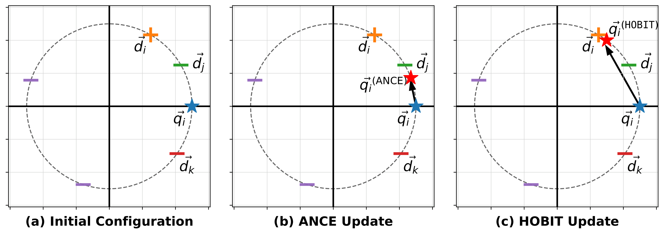

Why is $t_{ij}$important?
Notes:
We motivate HOBIT's hardness measure using a simple 2D toy example.
In the first panel, we show a query (q_i), its positive document (d_i), and two candidate negatives, (d_j) and (d_k).
ANCE selects (d_j) because it is highly similar to the query. However, (d_j) is also very similar to the positive document (d_i). In contrast, HOBIT selects (d_k), which remains hard for the query while being well separated from the positive.
We can clearly see that the gradient induced by HOBIT moves the query embedding more directly toward the positive document. With ANCE, the negative can interfere with the positive signal, resulting in a less effective update.

Slide 17
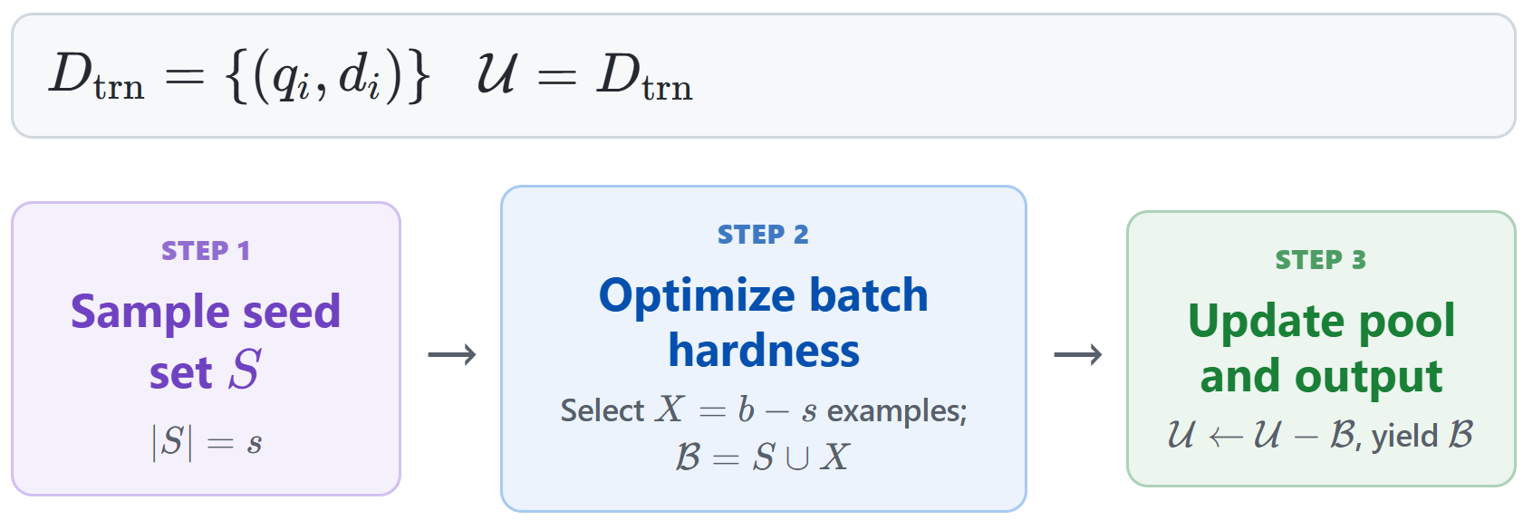
Batch Construction
Notes:
At a high level, this is how HOBIT constructs mini-batches.
For each batch, we first randomly sample a small set of seed query–document pairs. We then populate the remainder of the batch with pairs that maximize the hardness measure for the queries in this seed set.

Slide 18
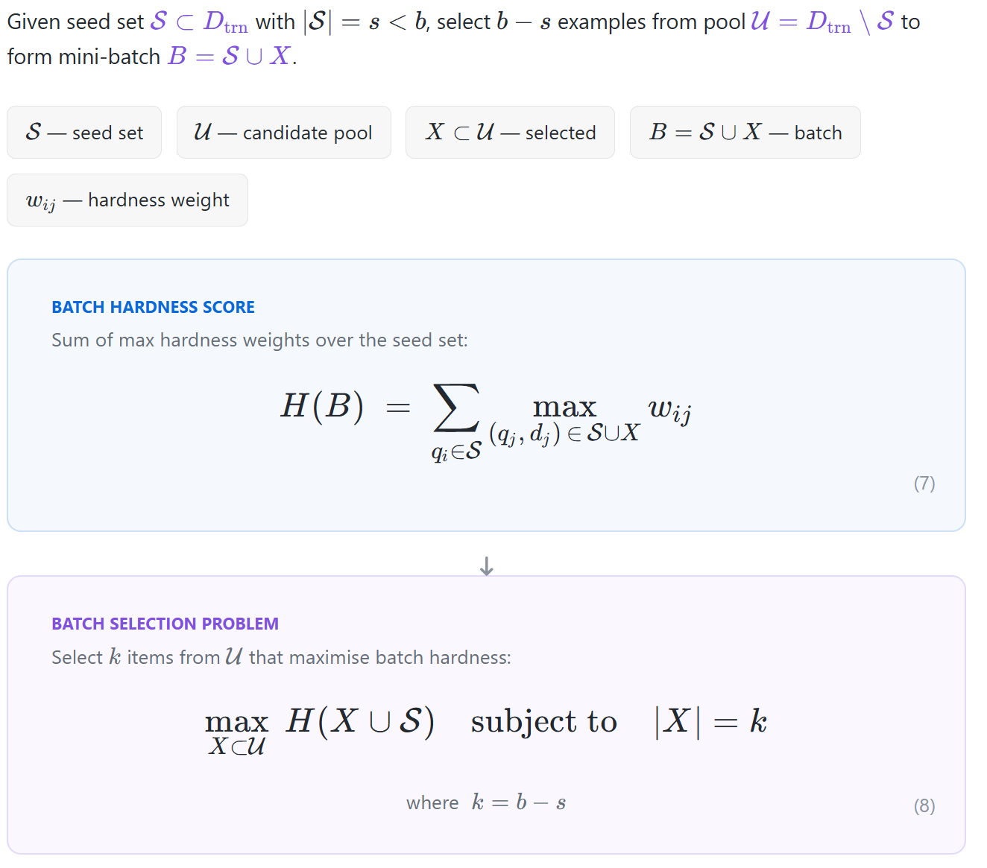
Batch Hardness
This is NP Hard
Notes:
This leads to the following batch hardness objective.
For each query (q_i) in the seed set, we define its hardness as the maximum (w_{ij}) over all pairs in the batch. Notice that this maximization is performed over the entire batch, including the seed set itself.
Our goal is then to find a set (X) of training pairs that maximizes this objective.
Unfortunately, this optimization problem is NP-hard. We prove this through a reduction from the Maximum Coverage problem, but I will skip the details of the reduction in the interest of time.

Slide 19
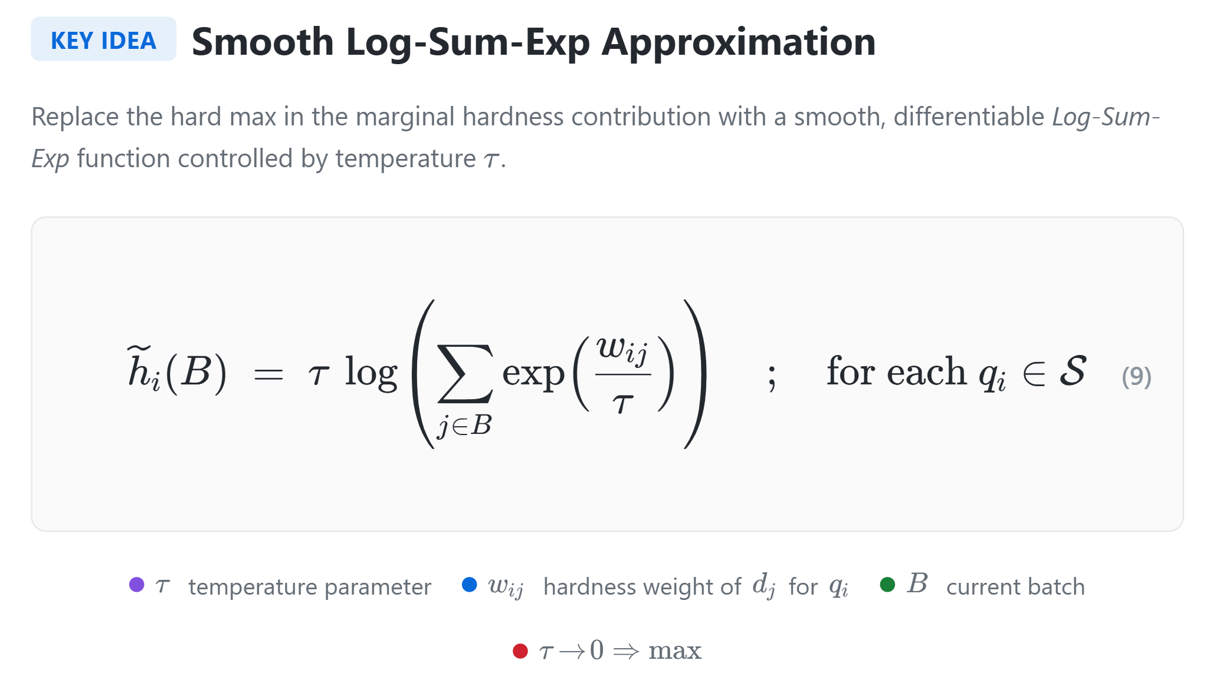
Tractable Objective
Notes:
To overcome the NP-hardness, we apply a standard relaxation.
The key idea is to replace the hard maximum over the (w_{ij}) scores in the HOBIT objective with a smooth log-sum-exp approximation with a temperature \tau.
This is a well-known technique in convex optimization, and it gives us an objective with much nicer optimization properties.

Slide 20
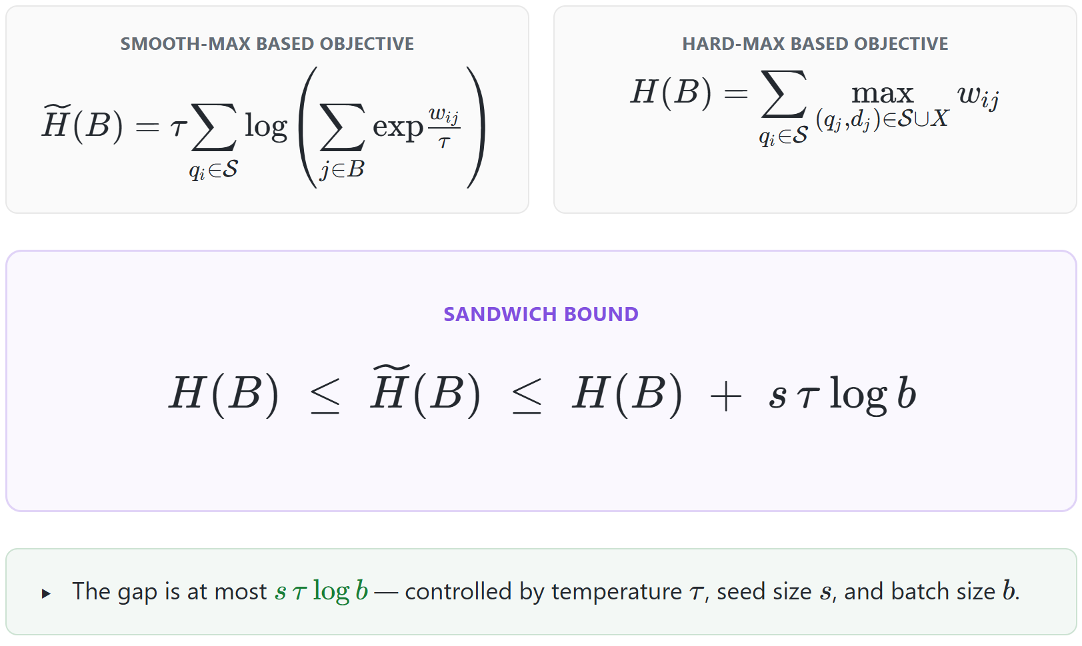
Sandwich Bound
Notes:
In fact, we can show that this log-sum-exp objective is both lower- and upper-bounded by the hard-max objective, up to a constant that depends on the seed set size, the softmax temperature \tau, and the batch size (b).
The softmax temperature \tau plays a crucial role in our analysis.

Slide 21
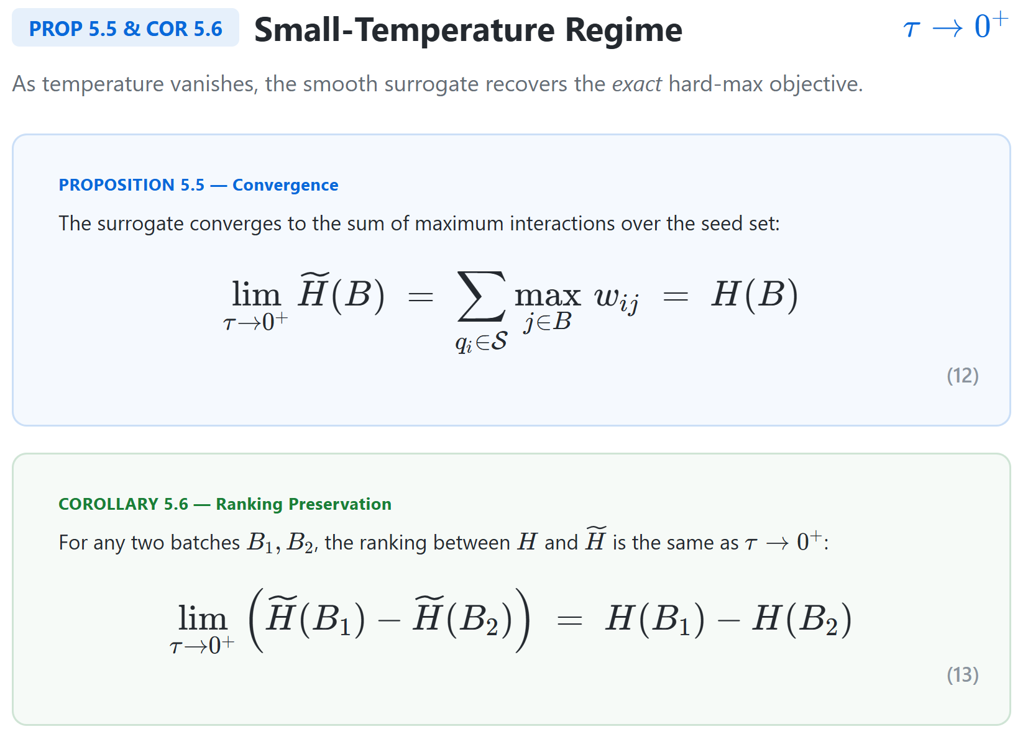
Notes:
When \tau is close to 0, we recover the batches that would be obtained by solving the hard max objective

Slide 22
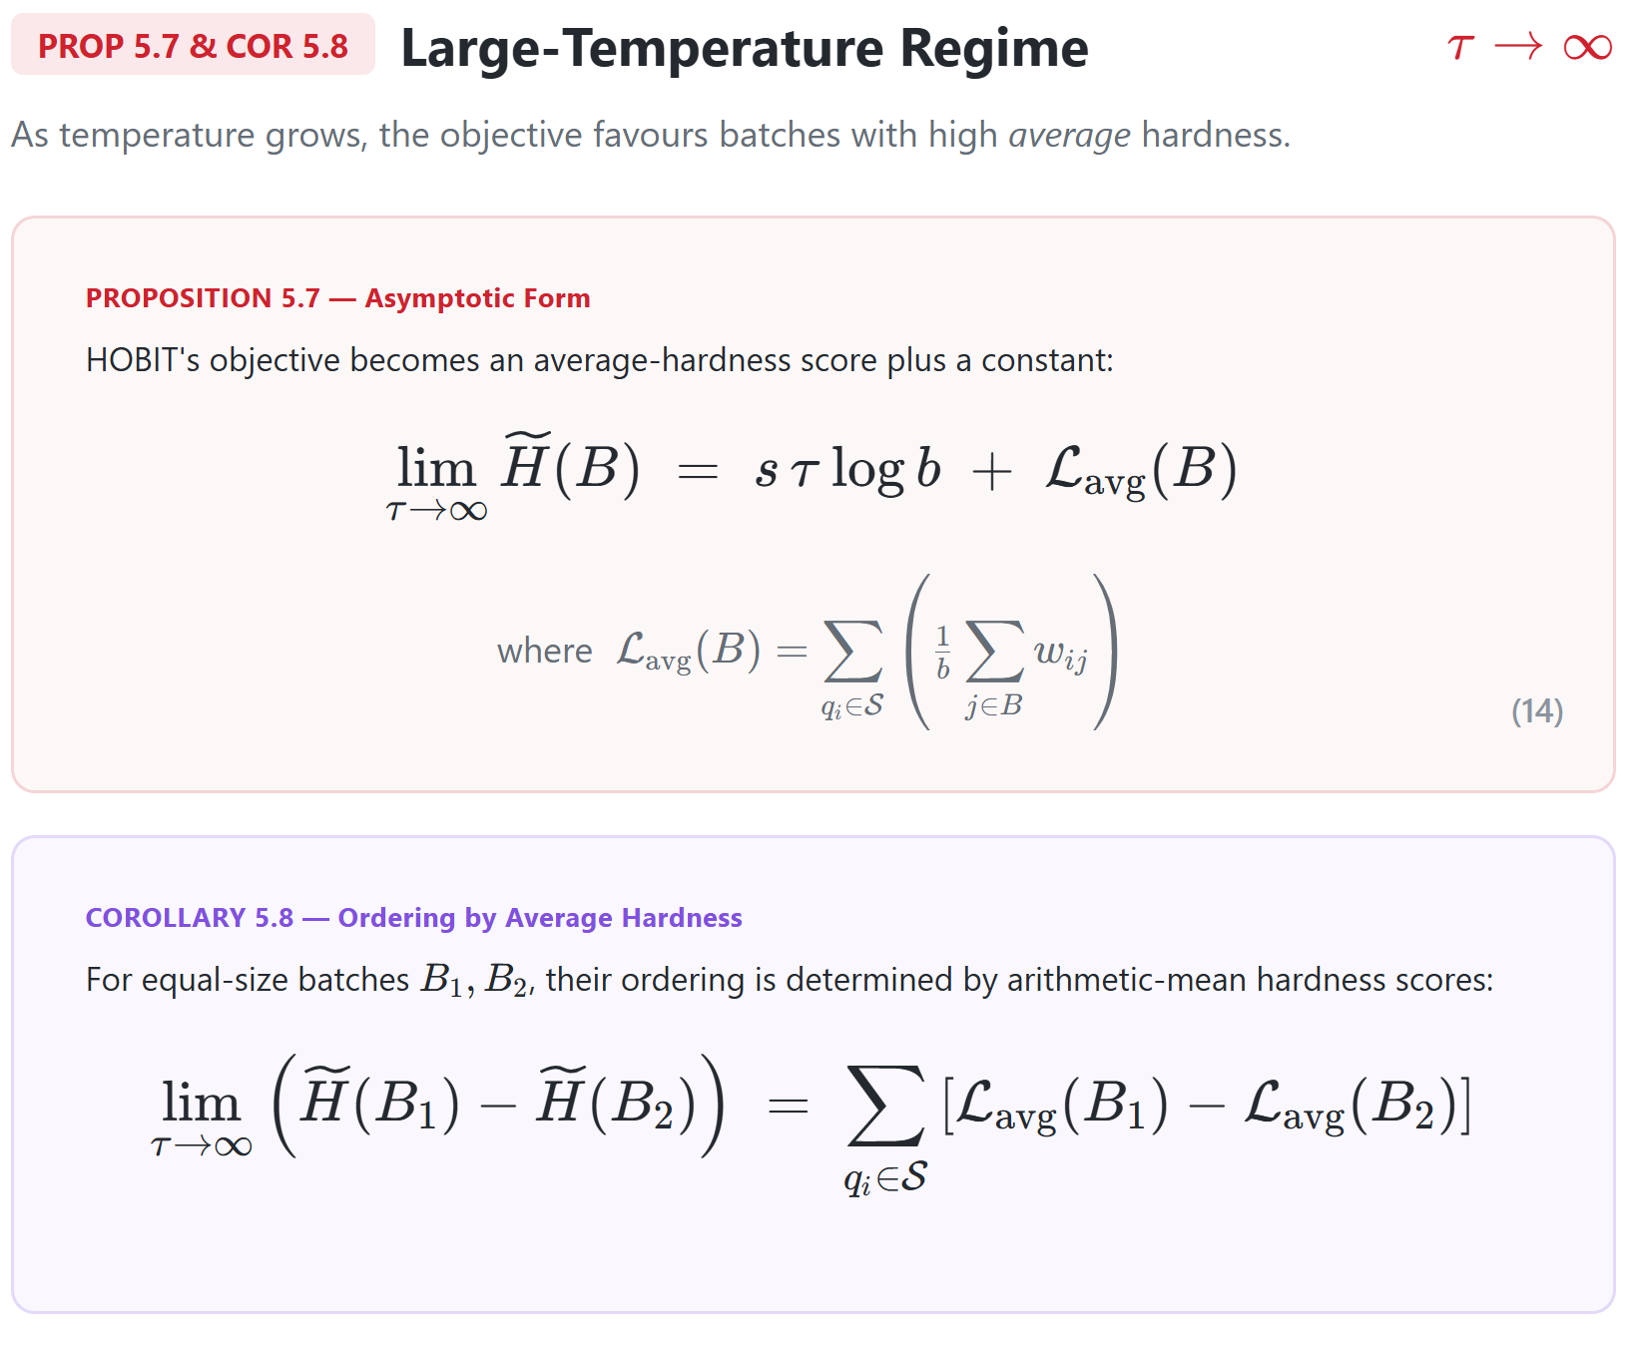
Notes:
When (\tau) becomes very large, the objective reduces to an average-hardness objective. In other words, instead of taking the maximum over the (w_{ij}) scores, we simply compute their mean.

Slide 23
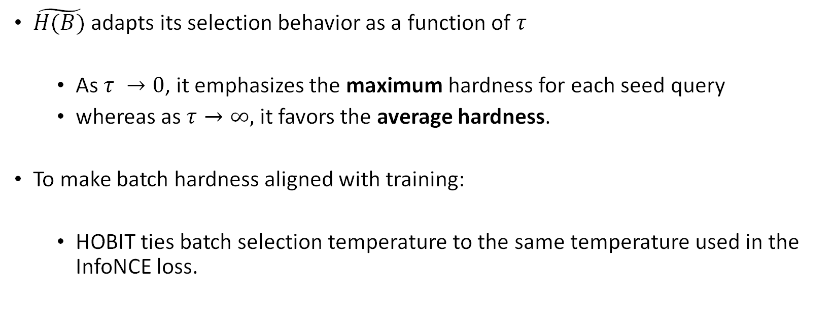
Implication
$\tilde{H(B)}$ adapts its selection behavior as a function of $τ$
  As $τ →0$, it emphasizes the maximum hardness for each seed query
  whereas as $τ→∞,$ it favors the average hardness.
To make batch hardness aligned with training:
  HOBIT ties batch selection temperature to the same temperature used in the InfoNCE loss.
Notes:
So, in summary, HOBIT supports two different hardness regimes, controlled by the temperature parameter.
At one extreme, it focuses on the single hardest example, while at the other, it optimizes for average hardness across the batch.
In our experiments, we found that the best performance is achieved when the HOBIT temperature is tied to the temperature used in the InfoNCE loss. This is intuitive, since the notion of what constitutes a hard negative should ultimately be dictated by the training objective itself.

Slide 24
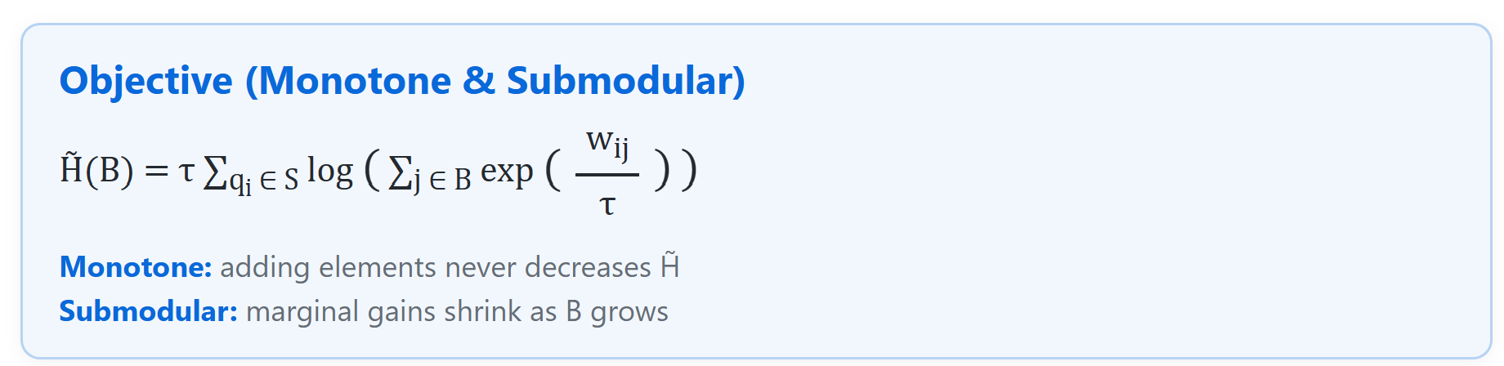
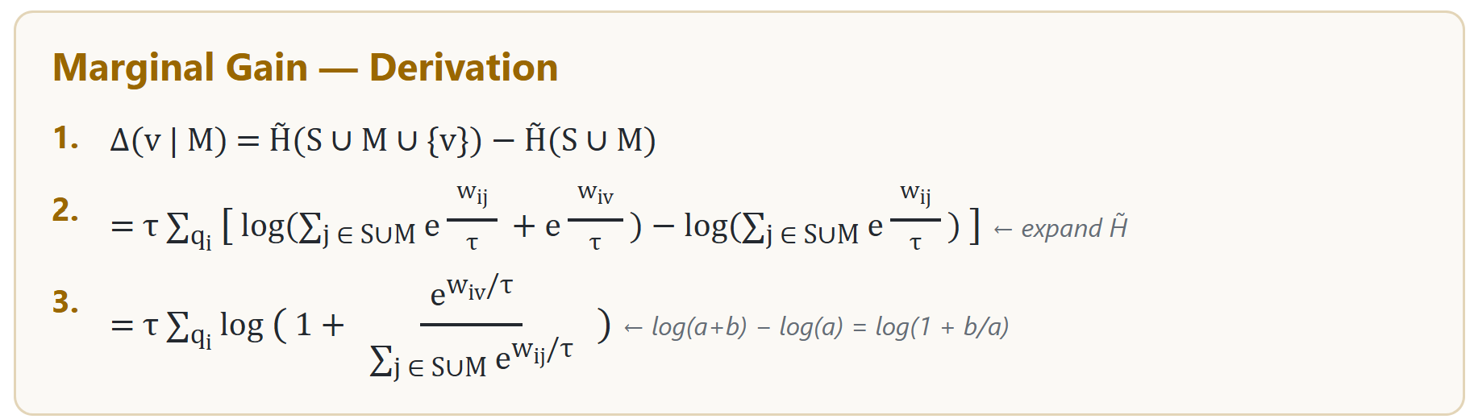
Greedy Algorithm
Notes:
Now let us come to the interesting part: how we actually optimize the objective.
The first step is to show that the objective is both monotone and submodular. This follows from a relatively straightforward analysis, which I will skip.
The key consequence is that we can optimize the objective greedily while still obtaining a ((1 - 1/e)) approximation guarantee.

Slide 25
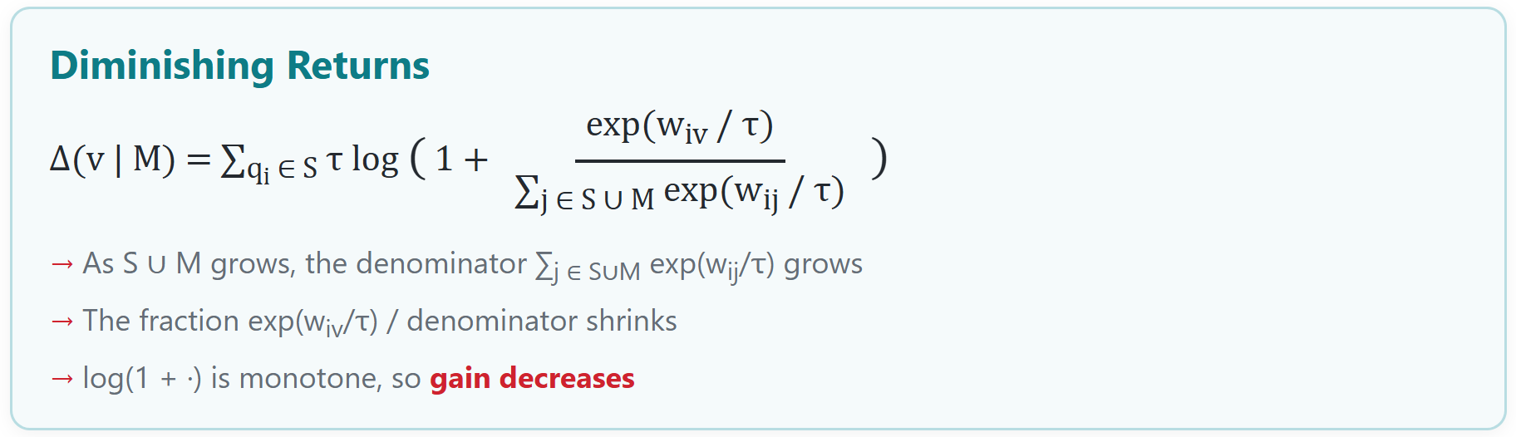
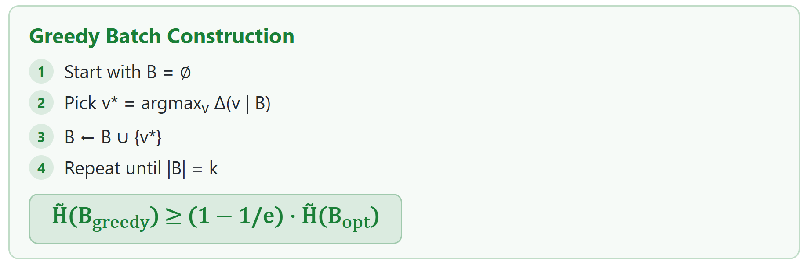
Greedy Algorithm
Notes:
This is the greedy batch construction loop.
At each iteration, we add the example that yields the largest marginal gain in the objective. While this may appear expensive, the entire procedure can be efficiently vectorized, allowing us to keep the runtime overhead relatively small in practice.

Slide 26
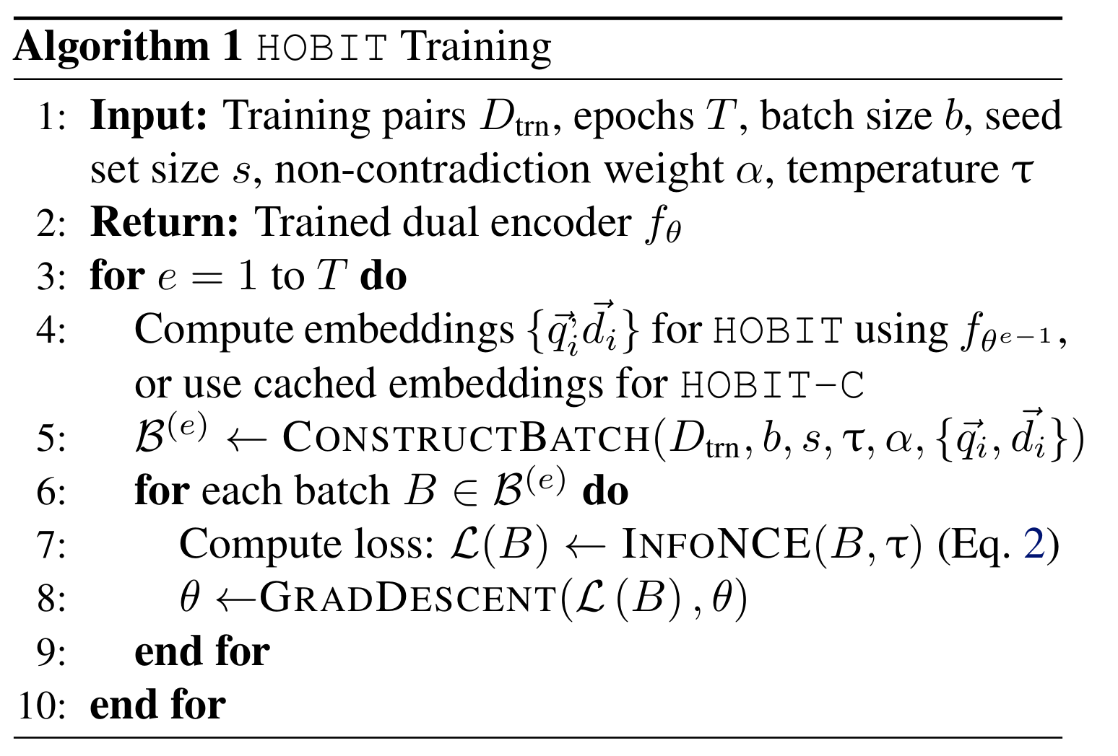
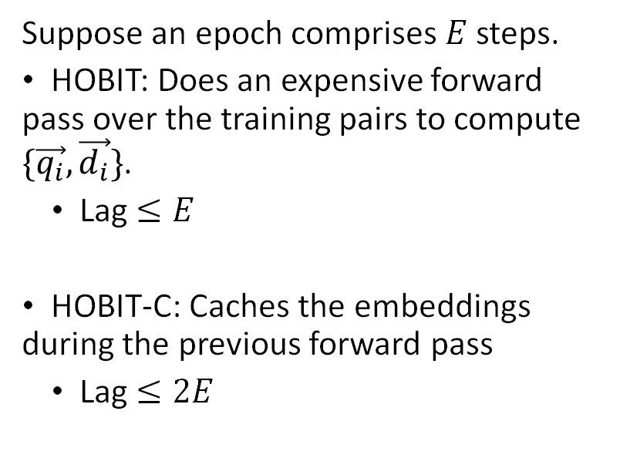
Pseudocode
Suppose an epoch comprises $E$ steps.
HOBIT: Does an expensive forward pass over the training pairs to compute $\{\vec{q_{i}}, \vec{d_{i}}\}$.
  Lag $≤E$
HOBIT-C: Caches the embeddings during the previous forward pass
  Lag $≤2E$
Notes:
To execute the greedy algorithm, we need query and document embeddings. Since recomputing them during batch construction is too expensive, we propose two practical variants: HOBIT and HOBIT-C C for cache.
HOBIT computes embeddings at the end of each epoch and uses them to construct the batches for the next epoch.
HOBIT-C instead uses embeddings cached from the previous epoch, making batch construction even cheaper.
In the paper, we establish theoretical guarantees for both variants.

Slide 27
Experiments: Baselines
Random: uniformly shuffles training instances at each epoch.
NGAME: clusters the query embeddings to group semantically similar queries within the same batch (Dahiya et al., 2023).
BS: constructs batches via graph-based random walks over query-query similarity graphs (Yang et al., 2023).
B3: Forms semantically coherent batches using teacher-guided representations and graph partitioning (Thirukovalluru et al., 2025).
Notes:
Now let us move on to the experimental evaluation.
We compare HOBIT against four state-of-the-art batching strategies and evaluate them across three retrieval benchmarks.

Slide 28
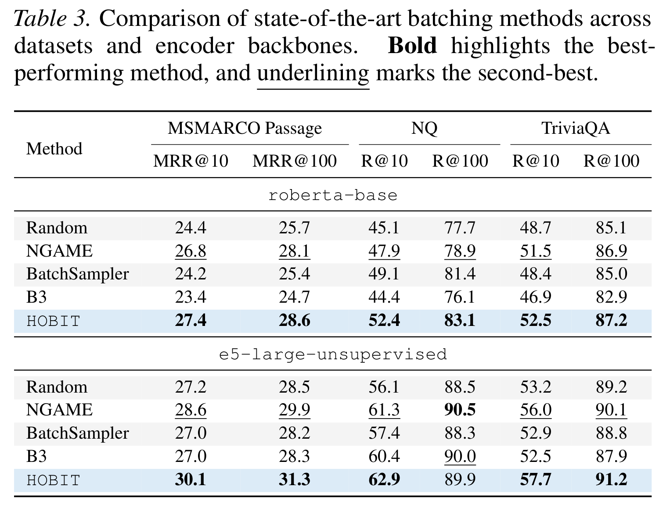
Comparison with SOTA Batching Methods
Notes:
Here are the results against competing batching methods.
Overall, HOBIT delivers the strongest performance and achieves sizable gains on several datasets.
One result worth highlighting is the large gap between random batching and HOBIT which is very large.

Slide 29
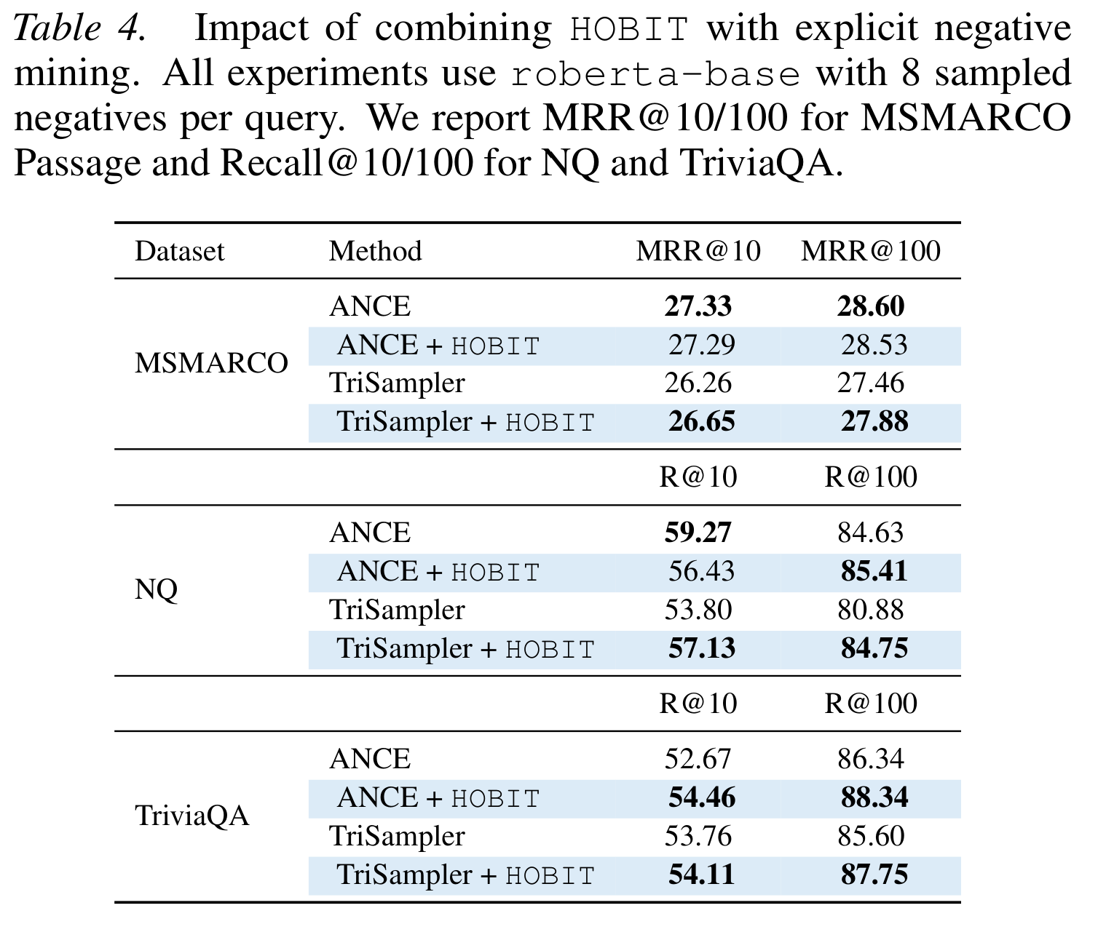
Adding HOBIT to Hard Negative Mining
Notes:
Next, we evaluate HOBIT in a setting where hard negatives are already available.
We find that applying HOBIT on top of existing hard-negative mining either preserves performance or provides modest improvements across most datasets.
The only exception is the Natural Questions dataset at Recall@10, where we observe a noticeable drop. However, even for this dataset, Recall@100 still improves.

Slide 30
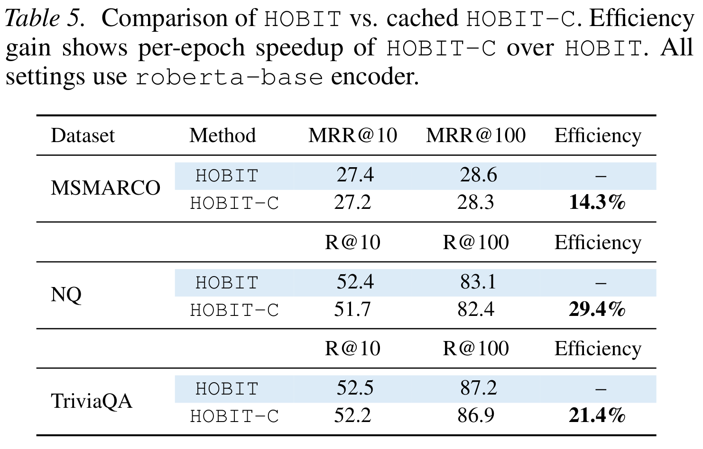
Comparing HOBIT with HOBIT-C
Notes:
Comparing HOBIT and HOBIT-C, we observe that HOBIT-C consistently achieves lower retrieval accuracy, though the gaps are very marginal.
However, HOBIT-C delivers significant efficiency benefits by reusing cached embeddings.
Given this favorable accuracy–efficiency trade-off, I will recommend HOBIT-C as the more practical choice in real-world deployments. Note that HOBIT-C also beats random with large margins.

Slide 31
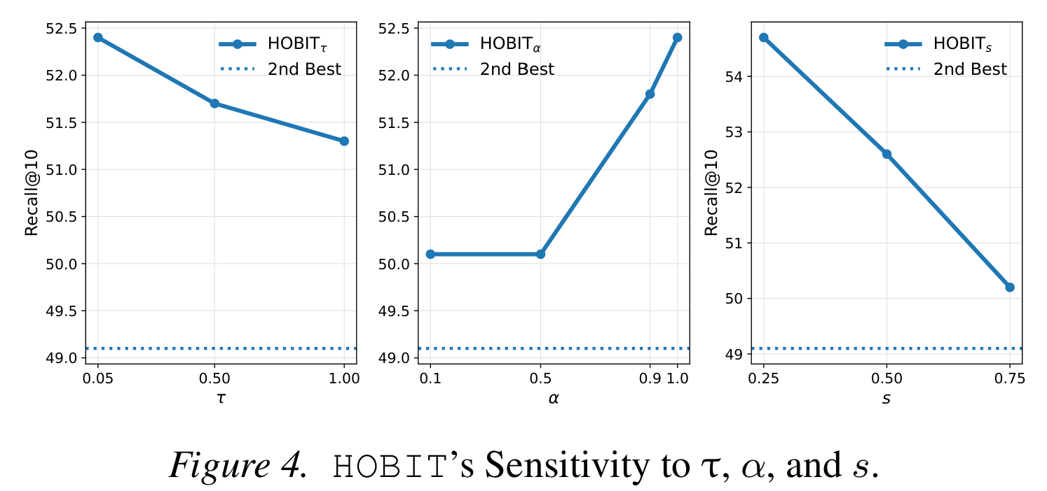

Sensitivity to $τ, α,$and $s$
Notes:
We next study the sensitivity of HOBIT to its three hyperparameters: the temperature (\tau), the weight (\alpha) on the (d_i \cdot d_j) term, and the seed set size.
For the temperature, we find that (\tau = 0.05) gives the best performance. Interestingly, this is also the temperature used in the InfoNCE loss, which aligns with our earlier intuition.
For (\alpha), the best results are obtained at (\alpha = 1). This highlights the importance of the (d_i \cdot d_j) term when selecting hard negatives. This is something that all the prior methods ignore.
Finally, smaller seed sets perform better because they provide HOBIT with greater flexibility in constructing informative batches.
This is one aspect I am proud about HOBIT. We did not require extensive hyperparameter tuning. Setting these to this default config worked across all three datasets.

Slide 32
Conclusion
HOBIT is a principled batching strategy for InfoNCE loss-based training of dual encoder models.
In practice, HOBIT-C is a very promising alternative to the current standard of applying random batching or expensive hard negative mining.
Showed very good promise in academic scale datasets without having to tune any hyper-parameters at all.
HOBIT-stream (ongoing work) has a large impact on industry settings.

