Slide 1
JDBI Talk
Lokesh Nagalapatti

Slide 2
Talk Outline
Data is an important asset
Overview of Data Quality
Some popular Data Quality issues
Data Cleaning
Class Imbalance
Label Noise
Data Valuation
Data Homogeneity
Data Transformations
An intuitive ML algorithm: Decision Tree

Slide 3
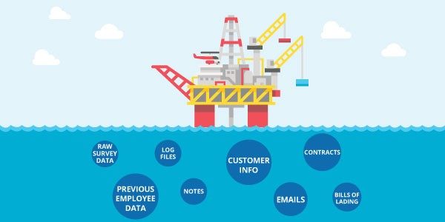
Data is the new oil
William Edwards Deming, “In God we trust; all others must bring data.”
https://medium.com/@adeolaadesina/data-is-the-new-oil-2947ed8804f6

Slide 4
Why do we say that?
Data is an essential resource that powers the information economy in much the way that oil has fueled the industrial economy
Information can be extracted from data just as energy can be extracted from oil
Data flows like oil but we must “drill down” into data to extract value from it
Oil is a scarce resource. Data isn’t just abundant, it is a cumulative resource

Slide 5
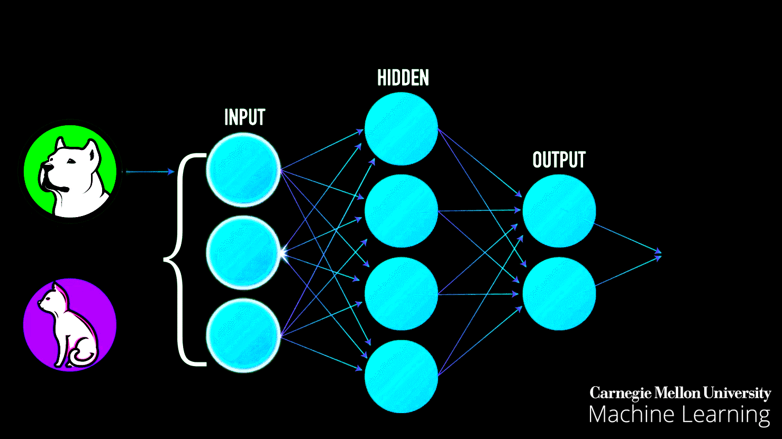
What is Machine Learning?
Machine learning is the study of computer algorithms that allow computer programs to automatically improve through data.
Here is the catch: Good the data, better the algorithm.

Slide 6
Real world scenario
Real world data is often noisy and is not readily consumable by ML algorithms

Slide 7
Hence, we would discuss first on “Overview and importance of Data Quality for AI”

Slide 8
Data Preparation in Machine Learning
“Data collection and preparation are typically
the most time-consuming activities in developing
an AI-based application, much more so than
selecting and tuning a model.” – MIT Sloan Survey
https://sloanreview.mit.edu/projects/reshaping-business-with-artificial-intelligence/
Data preparation accounts for about 80% of the work of data scientists” - Forbes
https://www.forbes.com/sites/gilpress/2016/03/23/data-preparation-most-time-consuming-least-enjoyable-data-science-task-survey-says/#70d9599b6f63

Slide 9
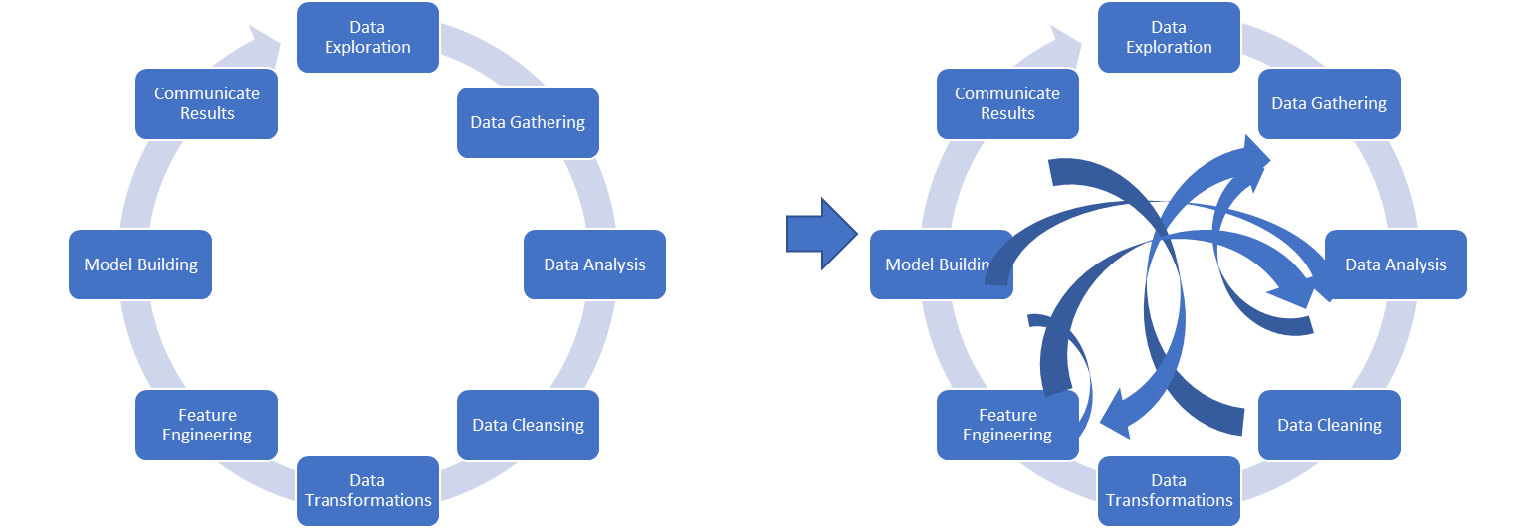
Challenges with Data Preparation

Slide 10
Data Quality Analysis can help..
Know
Know the issues in the data beforehand, example noise in labels, overlap between classes.
Make
Make informed choices for data preprocessing and model selection
Reduce
Reduce turn around time for data science projects.

Slide 11
To put it all together
Data Assessment and Readiness Module
Need for algorithms that can assess training datasets
Across modalities.. Structured/unstructured/timeseries etc
Allow for complex interaction between the different personas and human in loop techniques
Need for automation

Slide 12
To summarize:
Lot of progress in last several years on improving ML algorithms including building automated machine learning toolkits (AutoML)
However, Quality of a ML model is directly proportional to Quality of Data
Hence, there is a need for systematic study of measuring quality of data with respect to machine learning tasks.

Slide 13
Some popular Data Quality Issues
Data Cleaning
Class Imbalance
Label Noise
Data Valuation
Data Homogeneity
Data Transformations
Source: https://www.analyticsinsight.net/data-literacy-helping-enterprises-lead-with-data-through-challenging-times/

Slide 14
Data Cleaning
What are some common data cleaning techniques used for machine learning?
Do data cleaning techniques always help in building a machine learning pipeline
Joint cleaning and model building techniques

Slide 15
Common Data Cleaning Techniques
Data Cleaning Issues
Quantitative
Qualitative
Missing Values
Outliers
Noise in the data
Noise in labels
Data Linters
…
Integrity Constraints based errors (not covered)
- Functional Dependency Constraints
- Denial Constraints
- Others ..

Slide 16
Some insights on Data Cleaning
[LXJ19] [LAU19]
Data cleaning does not necessarily improve the quality of downstream ML models
Impact depends on different factors:
Cleaning algorithm and its set of parameters
ML model dependent
Order of cleaning operators
Model selection and cleaning algorithm can increase robustness of impacts – no one solution!

Slide 17
Data Quality Metrics
We will cover the following topics:
Data Cleaning
Class Imbalance
Label Noise
Data Valuation
Data Homogeneity
Data Transformations
Source: https://www.analyticsinsight.net/data-literacy-helping-enterprises-lead-with-data-through-challenging-times/

Slide 18
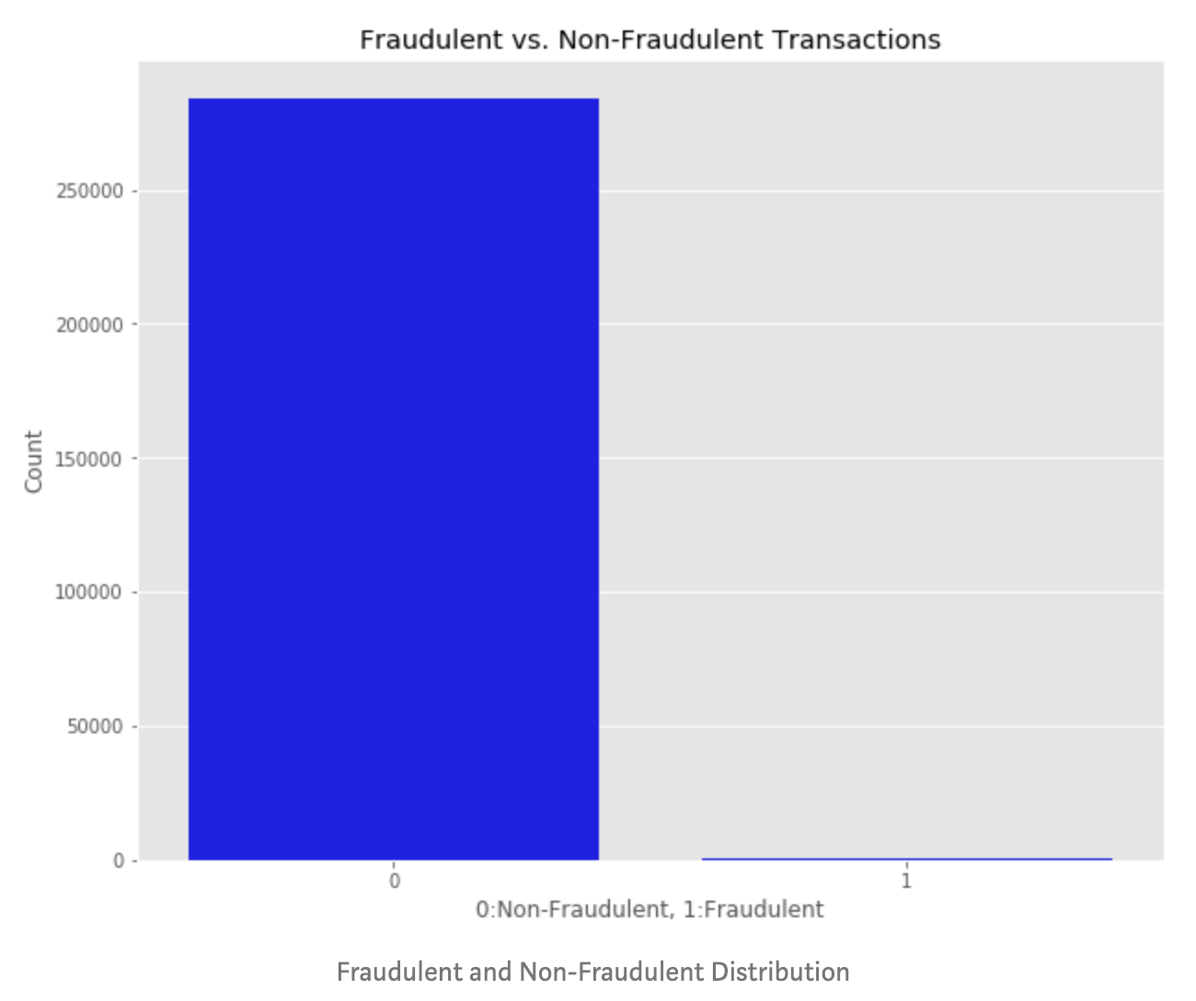
Class Imbalance
Unequal distribution of classes within a dataset
Source: https://towardsdatascience.com/credit-card-fraud-detection-a1c7e1b75f59
Notes:
Image Taken from: https://towardsdatascience.com/credit-card-fraud-detection-a1c7e1b75f59

Slide 19
Why it happens?
[Kra16]
Expected in domains where data with one pattern is more common than other.
Source: Krawczyk et al, 2016. Learning from imbalanced data: open challenges and future direction
Notes:
Example, most of the transactions belongs to ”Non-Fraud” and a very few transactions belongs to ”Fraud”, which leads to data imbalance.
Taken from: Learning from imbalanced data: open challenges and future directions https://link.springer.com/article/10.1007/s13748-016-0094-0

Slide 20
Why Imbalanced Classification is Hard?
Classifier assumes data to be balanced
Unequal Cost of Misclassification Errors: False negatives are important than False positives
Minority Class is more important for data mining but given less priority by learning algorithm
Minority class instances can be detected as noise

Slide 21
Evaluation Metrics for Imbalanced Datasets
Accuracy Paradox
Always Predict
Learning Algorithm
Reasonable ?
Accuracy = 90%
90% Majority
10% Minority
F1 Score, Recall, AUC PR, AUC ROC, G-Mean….
Source: https://en.wikipedia.org/wiki/Accuracy_paradox
Notes:
https://en.wikipedia.org/wiki/Accuracy_paradox

Slide 22
Factors affecting class imbalance
Imbalance Ratio
Overlap between classes
Smaller sub-concepts
Dataset Size
Label Noise
Combination
…

Slide 23
To overcome Imbalance: Sampling datasets
Oversampling
Undersampling
Ensemble Based Techniques
Does imbalance recovery method always help?
OR
Does the Impact of imbalance recovery method same on all datasets.

Slide 24
Data Quality Metrics
We will cover the following topics:
Data Cleaning
Class Imbalance
Label Noise
Data Valuation
Data Homogeneity
Data Transformations
Source: https://www.analyticsinsight.net/data-literacy-helping-enterprises-lead-with-data-through-challenging-times/

Slide 25
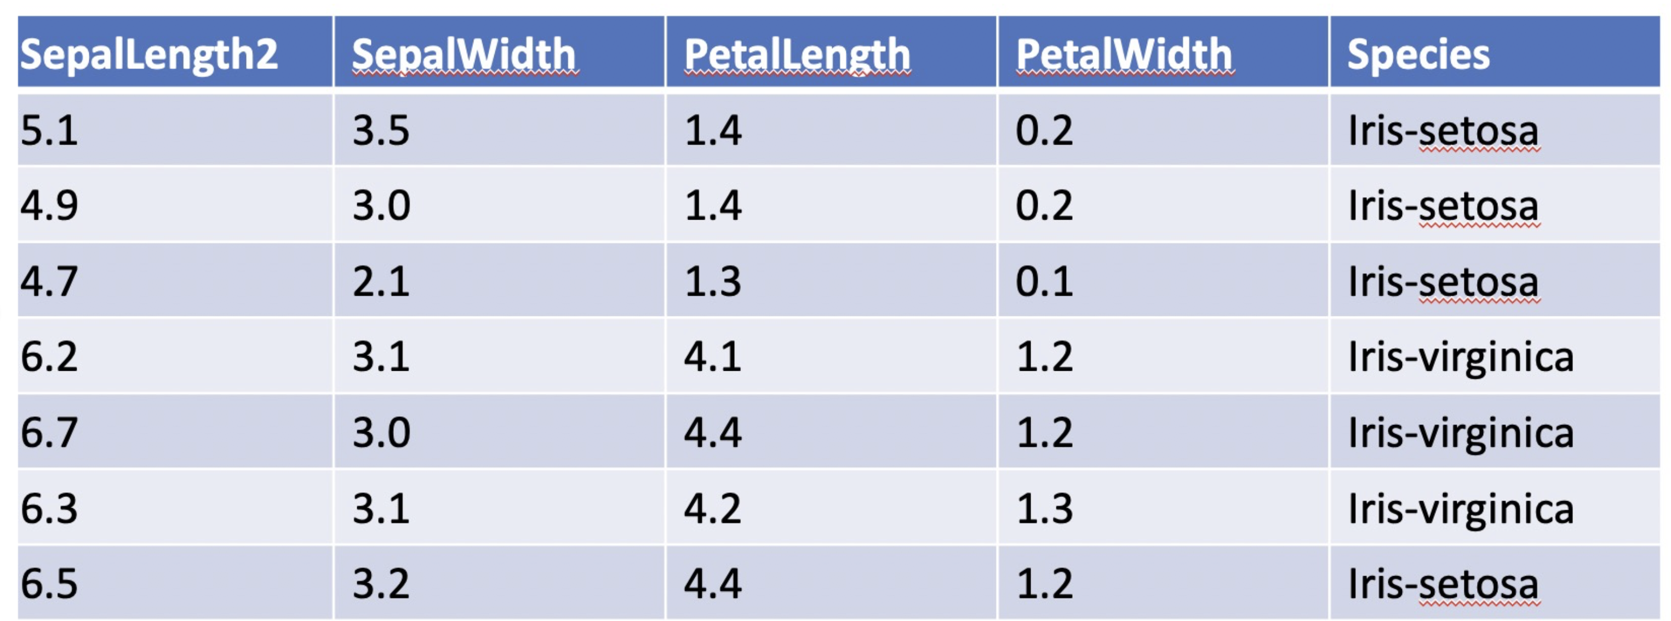
Label Noise
Source: https://l7.curtisnorthcutt.com/confident-learning
Most of the large data generated or annotated have some noisy labels.
In this metric we discuss “How one can identify these label errors and correct them to model data better?”.
Given Label – Iris-setosa Correct Label –Iris-virginica (based on attributes analysis)
There are atleast 100,000 label issues is ImageNet!

Slide 26
Effects of Label Noise
Label noise can have several effects:
Decrease in classification performance
Pose a threat to tasks like feature selection
In online settings, new labelled data may contradict the original labelled data
Possible Sources of Label Noise:
Insufficient information provided to the labeler
Errors in the labelling itself
Subjectivity of the labelling task
Communication/encoding problems

Slide 27
Label Noise Techniques
‘
Label Noise
Algorithm Level Approaches
Data Level Approaches
Designing robust algorithms that are insensitive to noise
Not directly extensible to other learning algorithms
Requires to change an existing method, which neither is always possible nor easy to develop
Filtering out noise before passing to underlying ML task
Independent of the classification algorithm
Helps in improving classification accuracy and reduced model complexity.

Slide 28
Label Noise Techniques
‘
Label Noise
Algorithm Level Approaches
Data Level Approaches
Identifying mislabelled training data (Journal of artificial intelligence research 1999)
On the labeling correctness in computer vision datasets (IAL 2018)
Finding label noise examples in large scale datasets (SMC 2017)
Confident Learning: Estimating Uncertainty in Dataset Label (Arxiv -2019)
Learning with Noisy Labels (NIPS-2014)
Robust Loss Functions under Label Noise for Deep Neural Networks (AAAI-2017)
Probabilistic End-To-End Noise Correction for Learning With Noisy Labels (CVPR-2019)
Can Gradient Clipping Mitigate Label Noise? (ICLR-2020)

Slide 29
Data Quality Metrics
We will cover the following topics:
Data Cleaning
Class Imbalance
Label Noise
Data Valuation
Data Homogeneity
Data Transformations
Source: https://www.analyticsinsight.net/data-literacy-helping-enterprises-lead-with-data-through-challenging-times/

Slide 30
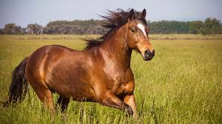
Data Valuation: This is a new concept
Value of a training datum is how much impact it has in the predictor performance.
Data Valuation
Training Data
High Valued
Prediction Model
Valuation
Model
Low Valued
Validation Data
Source: Google Images

Slide 31
$$A:Learning Algorithm \\ V:Validation Set \\ x:Training Datum \\ P\left(x,A,V\right):Performance of A on V using x \\ Val\left(x,A,V\right):Impact of x in performance of A on V$$
Is the impact of all the cat images from training set same?
Is
$$P\left( , A,V\right)==P( ,A, V)$$
?
Then
$$Val( ,A,V)==Val( ,A,V)$$
Source: Google Images

Slide 32
Scenarios in which datum has low value:
Incorrect label
Input is noisy or low quality
Usefulness for target task
Label: Dog
Label: Dog
Label: Dog
Label: Dog
Validation Set
Source: Google Images
Notes:
…

Slide 33
Application
Identifying Data Quality
High value data ➔ Significant contribution
Low value data ➔ Noise or outliers or not useful for task
Domain Adaptation
Data Gathering

Slide 34
Data Quality Metrics
We will cover the following topics:
Data Cleaning
Class Imbalance
Label Noise
Data Valuation
Data Homogeneity
Data Transformations
Source: https://www.analyticsinsight.net/data-literacy-helping-enterprises-lead-with-data-through-challenging-times/

Slide 35
Data Homogeneity
We call a data homogenous, if all the entries follow a unique pattern
Homogeneity
Syntactic
Distance matching
Pattern matching
Context matching
Semantic
Embedding matching

Slide 36
Data Homogeneity
Homogenous
Homogenous
12th Jan, 2020
Account Manager
12/01/2020
Acc. Manager
12th Jan, 2020
Account Manager
12/01/2020
Acc. Manager
In-homogenous
Two different date formats
Two different values for the same category

Slide 37
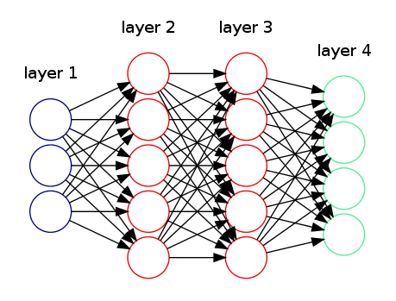
In-homogeneity affects ML pipeline
Adult Census dataset downloaded from Kaggle
Task is to predict Income level (>50k/<=50k) given several attributes of a person
4 output neurons?
Income level (Train) | Income level (Test)
<=50K | <=50K.
<=50K | <=50K.
>50K | >50K.
<=50K | >50K.
<=50K | <=50K.
<=50K | <=50K.
>50K | <=50K.
>50K | >50K.
Source: Image from Google Images

Slide 38
Inhomogeneity causes
When data is gathered by different people
In the absence (or weak presence) of a data collection protocol
When data is merged from different sources
When data is stored in different formats (e.g. .csv, .xlsx) etc.
Inhomogeneity

Slide 39
Syntactic Homogeneity
Distance based similarity
Jaccard Similarity
Edit distance
y0 y1 y2 y3 y4
$$J\left(x,y\right)=\frac{{|B}_{x}∩B_{y}|}{{|B}_{x}∪B_{y}|}$$
Eg$. x$= dave, $y$ = dav
$B_x = \{\#d, da, av, ve, e\#\}, B_y = \{\#d, da, av, v\#\}$
$J(x,y) = 3/6$
 |  | d | a | v | e
 | 0 | 1 | 2 | 3 | 4
d | 1 | 0 | 1 | 2 | 3
v | 2 | 1 | 1 | 1 | 2
a | 3 | 2 | 1 | 2 | 2
x = d – v a
y = d a v e
substitute a with e
insert a (after d)
Sequence based distance measure
Set based distance measure
Source: Doan et al, 2012. Principles of Data Integration

Slide 40
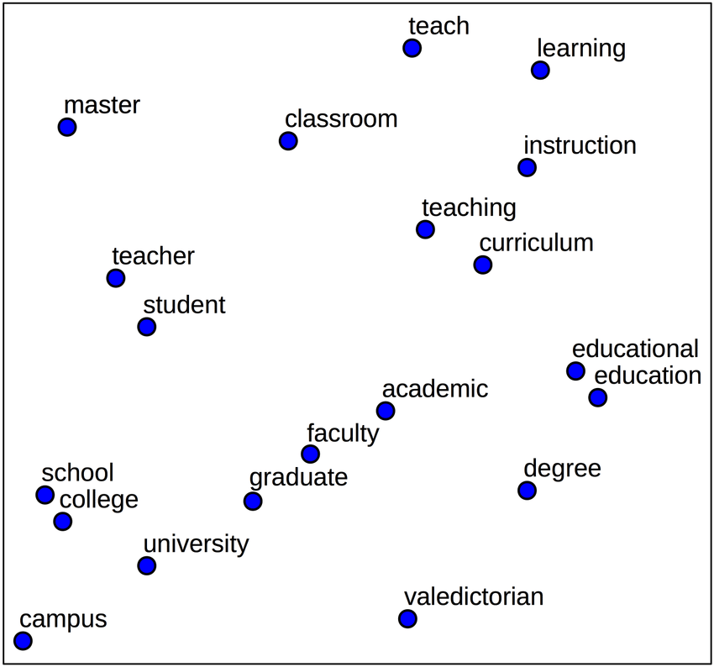
Semantic Homogeneity
[MCCD13]
Embeddings based similarity
Applicable when the entries in the data are meaningful English words
Can use off the shelf embeddings like word2vec, Glove etc.
$similarity\left(x,y\right)=cosine\left(φ\left(x\right), φ\left(y\right)\right);$
$φ\left(.\right)=word embedding$
Embeddings capture semantic information as well
Source: Mikolov et al, 2012. Efficient estimation of word representations in vector space

Slide 41
Data Quality Metrics
We will cover the following topics:
Data Cleaning
Class Imbalance
Label Noise
Data Valuation
Data Homogeneity
Data Transformations
Source: https://www.analyticsinsight.net/data-literacy-helping-enterprises-lead-with-data-through-challenging-times/
Notes:
….

Slide 42
Data Transformation
The goal is to allow the business user to transform provided data (heterogeneous) into user intended format (homogeneous), by showing a few examples of expected output for the given input samples.

Slide 43
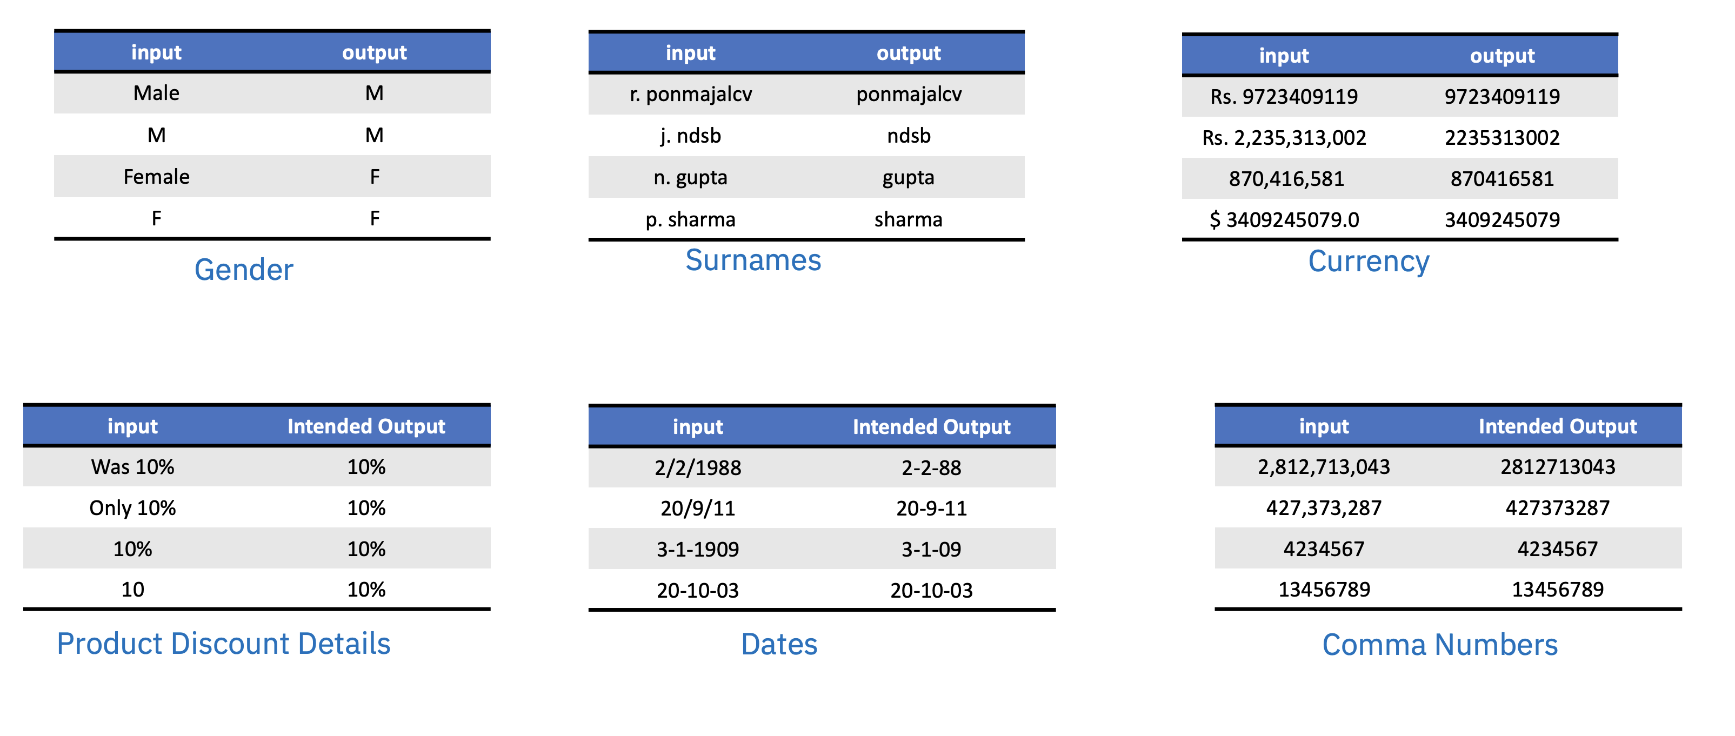
Data Transformation Examples

Slide 44
Data Transformation Using PbE Systems
Programming-by-Example systems capture user intent using sample input-output example pairs and learn transformation programs that convert inputs into their corresponding outputs.
User provided input-output example pairs
Decode/Search for Transformation Programs
Transformation Program
Program space expressed using a Domain-specific Language (DSL)
Fig 2. Generic process across all Programming-by-Example frameworks

Slide 45
We have learnt a lot of Quality issues
Be rest assured that it is only the tip of the iceberg
Now, let us see how to use data in building a Classifier

Slide 46
Assuming we have the correct data, let us look at a very intuitive ML Algorithm: Decision Tree

Slide 47
Decision Tree Algorithm
Comp328 tutorial 1
Thanks to: Kai Zhang (https://cszn.github.io/)

Slide 48
The problem
Given a set of training cases/objects and their attribute values, try to determine the target attribute value of new examples.
Classification
Prediction

Slide 49
Why decision tree?
Decision trees are powerful and popular tools for classification and prediction.
Decision trees represent rules, which can be understood by humans and used in knowledge system such as database.

Slide 50
A simple Example: Basketball data

Slide 51
What we know
The game will be away, at 9pm, and that Joe will play center on offense…
A classification problem
Generalizing the learned rule to new examples

Slide 52
Definition
Decision tree is a classifier in the form of a tree structure
Decision node: specifies a test on a single attribute
Leaf node: indicates the value of the target attribute
Arc/edge: split of one attribute
Decision trees classify instances or examples by starting at the root of the tree and moving through it until a leaf node.

Slide 53
Illustration
(1) Which to start? (root)
(2) Which node to proceed?
(3) When to stop/ come to conclusion?

Slide 54
Random split
The tree can grow huge
These trees are hard to understand.
Larger trees are typically less accurate than smaller trees (Occams Razor).
Finding the simplest Tree is NP-Hard (as all good problems are!)
We employ heuristics to construct trees in practice

Slide 55
Principled Criterion
Selection of an attribute to test at each node - choosing the most useful attribute for classifying examples.
information gain
measures how well a given attribute separates the training examples according to their target classification
This measure is used to select among the candidate attributes at each step while growing the tree

Slide 56
Entropy
A measure of homogeneity of the set of examples.
Given a set S of positive and negative examples of some target concept (a 2-class problem), the entropy of set S relative to this binary classification is
E(S) = - p(P)log2 p(P) – p(N)log2 p(N)

Slide 57
Suppose S has 25 examples, 15 positive and 10 negatives [15+, 10-]. Then the entropy of S relative to this classification is
E(S)=-(15/25) log2(15/25) - (10/25) log2 (10/25)

Slide 58
Some Intuitions
The entropy is 0 if the outcome is ``certain’’.
The entropy is maximum if we have no knowledge of the system (or any outcome is equally possible).
Entropy of a 2-class problem with regard to the portion of one of the two groups

Slide 59
Information Gain
Information gain measures the expected reduction in entropy, or uncertainty.
Values(A) is the set of all possible values for attribute A, and Sv the subset of S for which attribute A has value v Sv = {s in S | A(s) = v}.
the first term in the equation for Gain is just the entropy of the original collection S
the second term is the expected value of the entropy after S is partitioned using attribute A

Slide 60
It is simply the expected reduction in entropy caused by partitioning the examples according to this attribute.
It is the number of bits saved when encoding the target value of an arbitrary member of S, by knowing the value of attribute A.

Slide 61
Examples
Before partitioning, the entropy is
H(10/20, 10/20) = - 10/20 log(10/20) - 10/20 log(10/20) = 1
Using the ``where’’ attribute, divide into 2 subsets
Entropy of the first set H(home) = - 6/12 log(6/12) - 6/12 log(6/12) = 1
Entropy of the second set H(away) = - 4/8 log(6/8) - 4/8 log(4/8) = 1
Expected entropy after partitioning
12/20 * H(home) + 8/20 * H(away) = 1

Slide 62
Using the ``when’’ attribute, divide into 3 subsets
Entropy of the first set H(5pm) = - 1/4 log(1/4) - 3/4 log(3/4);
Entropy of the second set H(7pm) = - 9/12 log(9/12) - 3/12 log(3/12);
Entropy of the second set H(9pm) = - 0/4 log(0/4) - 4/4 log(4/4) = 0
Expected entropy after partitioning
4/20 * H(1/4, 3/4) + 12/20 * H(9/12, 3/12) + 4/20 * H(0/4, 4/4) = 0.65
Information gain 1-0.65 = 0.35

Slide 63
Decision
Knowing the ``when’’ attribute values provides larger information gain than ``where’’.
Therefore the ``when’’ attribute should be chosen for testing prior to the ``where’’ attribute.
Similarly, we can compute the information gain for other attributes.
At each node, choose the attribute with the largest information gain.

Slide 64
Stopping rule
Every attribute has already been included along this path through the tree, or
The training examples associated with this leaf node all have the same target attribute value (i.e., their entropy is zero).

Slide 65
Evaluation
Training accuracy
How many training instances can be correctly classify based on the available data?
Is high when the tree is deep/large, or when there is less confliction in the training instances.
however, higher training accuracy does not mean good generalization
Testing accuracy
Given a number of new instances, how many of them can we correctly classify?
Cross validation

Slide 66
References
[BF99] Carla E Brodley and Mark A Friedl. Identifying mislabeled training data. Journal of artificial intelligence research, 11:131–167, 1999. [ZWC03] Xingquan Zhu, Xindong Wu, and Qijun Chen. Eliminating class noise in large datasets. In Proceedings of the 20th International Conference on Machine Learning(ICML-03), pages 920–927, 2003.
[DLG17]J unhua Ding, XinChuan Li, and Venkat N Gudivada. Augmentation and evaluation of training data for deep learning. In2017 IEEE International Conference on Big Data(Big Data), pages 2603–2611. IEEE, 2017.
[ARK18] Mohammed Al-Rawi and Dimosthenis Karatzas. On the labeling correctness in computer vision datasets. In IAL@PKDD/ECML, 2018.
[NJC19] Curtis G Northcutt, Lu Jiang, and Isaac L Chuang. Confident learning: Estimating uncertainty in dataset labels. arXiv preprint arXiv:1911.00068, 2019.
[Coo77] R Dennis Cook. Detection of influential observation in linear regression.T echnometrics
[EGH17] Rajmadhan Ekambaram, Dmitry B Goldgof, and Lawrence O Hall. Finding label noise examples in large scale datasets. In2017 IEEE International Conference on Systems, Man, and Cybernetics pages 2420–2424., 2017.

Slide 67
References
[GZ19] Amirata Ghorbani and James Zou. Data shapley: Equitable valuation of data for machine learning. arXiv preprint arXiv:1904.02868, 2019
[YAP19] Jinsung Yoon, Sercan O Arik, and Tomas Pfister. Data valuation using reinforcement learning. arXiv preprint arXiv:1909.11671, 2019.
[DKO+07] Bing Tian Dai, Nick Koudas, Beng Chin Ooi, Divesh Srivastava, and Suresh Venkatasubramanian. Column heterogeneity as a measure of data quality. 2007
[sim] http://www.countrysideinfo.co.uk/simpsons.htm.
[DHI12] AnHai Doan, Alon Halevy, and Zachary Ives. Principles of data integration. Elsevier, 2012.
[MCCD13] Tomas Mikolov, Kai Chen, Greg Corrado, and Jeffrey Dean. Efficient estimation of word representations in vector space. arXiv preprint arXiv:1301.3781, 2013
[ALI15] Aida Ali and Siti Mariyam Hj. Shamsuddin and Anca L. Ralescu. Classification with class imbalance problem: A review. SOCO 2015

Slide 68
References
[PG15] Oleksandr Polozov and Sumit Gulwani. Flashmeta: a framework for inductive program synthesis. In Proceedings of the 2015 ACM SIGPLAN International Conference on Object-Oriented Programming, Systems, Languages, and Applications, pages 107–126, 2015. [DUB+17] Jacob Devlin, Jonathan Uesato, Surya Bhupatiraju, Rishabh Singh, Abdel-rahman Mohamed, and Pushmeet Kohli. Robustfill: Neural program learning under noisy i/o. In Proceedings of the 34th International Conference on Machine Learning-Volume 70, pages 990–998, 2017.
[KMP+18] Ashwin Kalyan, Abhishek Mohta, Oleksandr Polozov, Dhruv Batra, Prateek Jain, and Sumit Gulwani. Neural-guided deductive search for real-time program synthesis from examples. arXiv preprint arXiv:1804.01186, 2018.
[AYR16] Dimitrios Alikaniotis, Helen Yannakoudakis, and Marek Rei. Automatic text scoring using neural networks. In Proceedings of the 54th Annual Meeting of the Association for Computational Linguistics (Volume 1: Long Papers), pages 715–725, Berlin, Germany, August 2016. Association for Computational Linguistics.
[CPR19] Richard Csaky, Patrik Purgai, and Gabor Recski. Improving neural conversational models with entropy-based data filtering. arXiv preprint arXiv:1905.05471, 2019.

Slide 69
References
[CRZ18] Edward Collins, Nikolai Rozanov, and Bingbing Zhang. Evolutionary data measures: Understanding the difficulty of text classification tasks. arXiv preprint arXiv:1811.01910, 2018.
[JMAS19] Parag Jain, Abhijit Mishra, Amar Prakash Azad, and Karthik Sankaranarayanan. Unsupervised controllable text formalization. In Proceedings of the AAAI Conference on Artificial Intelligence, volume 33, pages 6554–6561, 2019.
[KWAP17] Ramakrishnan Kannan, Hyenkyun Woo, Charu C Aggarwal, and Haesun Park. Outlier detection for text data. In Proceedings of the 2017 siam international conference on data mining, pages 489–497. SIAM, 2017.
[MS18] Mohsen Mesgar and Michael Strube. A neural local coherence model for text quality assessment. In Proceedings of the 2018 Conference on Empirical Methods in Natural Language Processing, pages 4328–4339, 2018.
[ÖG17] Robert Östling and Gintar ̇e Grigonyt ̇e. Transparent text quality assessment with convolutional neural networks. In Proceedings of the 12th Workshop on Innovative Use of NLP for Building Educational Applications, pages 282–286, 2017.

Slide 70
References
[PLN19] Nicole Peinelt, Maria Liakata, and Dong Nguyen. Aiming beyond the obvious: Identifying non-obvious cases in semantic similarity datasets. In Proceedings of the 57th Annual Meeting of the Association for Computational Linguistics, pages 2792–2798, 2019.
[RDNMJ13] Marta Recasens, Cristian Danescu-Niculescu-Mizil, and Dan Jurafsky. Linguistic models for analyzing and detecting biased language. In Proceedings of the 51st Annual Meeting of the Association for Computational Linguistics (Volume 1: Long Papers), pages 1650–1659, 2013.
[RWGS20] Marco Tulio Ribeiro, Tongshuang Wu, Carlos Guestrin, and Sameer Singh. Beyond accuracy: Behavioral testing of nlp models with checklist. arXiv preprint arXiv:2005.04118, 2020.
[RZV+19] Lukas Ruff, Yury Zemlyanskiy, Robert Vandermeulen, Thomas Schnake, and Marius Kloft. Self-attentive, multi-context one-class classification for unsupervised anomaly detection on text. In Proceedings of the 57th Annual Meeting of the Association for Computational Linguistics, pages 4061–4071, 2019.
[RH01] Vijayshankar Raman and Joseph M Hellerstein. Potter’s wheel: An interactive data cleaning system. In VLDB, volume 1, pages 381–390, 2001.
[ROE+19] El Kindi Rezig, Mourad Ouzzani, Ahmed K Elmagarmid, Walid G Aref, and Michael Stonebraker. Towards an end-to-end human-centric data cleaning framework. In Proceedings of the Workshop on Human-In-the-Loop Data Analytics, pages 1–7, 2019.

Slide 71
References
[Ham13] Kelli Ham. Openrefine (version 2.5). http://openrefine. org. free, open-source tool for cleaning and transforming data. Journal of the Medical Library Association: JMLA, 101(3):233, 2013.
[KHFW16] Sanjay Krishnan, Daniel Haas, Michael J Franklin, and Eugene Wu. Towards reliable interactive data cleaning: A user survey and recommendations. In Proceedings of the Workshop on Human-In-the-Loop Data Analytics, pages 1–5, 2016.
[KPHH11] Sean Kandel, Andreas Paepcke, Joseph Hellerstein, and Jeffrey Heer. Wrangler: Interactive visual specification of data transformation scripts. In ACM Human Factors in Computing Systems (CHI), 2011.
[MLW+19] Michael Muller, Ingrid Lange, Dakuo Wang, David Piorkowski, Jason Tsay, Q Vera Liao, Casey Dugan, and Thomas Erickson. How data science workers work with data: Discovery, capture, curation, design, creation. In Proceedings of the 2019 CHI Conference on Human Factors in Computing Systems, pages 1–15, 2019.
[BTR15] Paula Branco, Luis Torgo, and Rita Ribeiro. A survey of predictive modelling under imbalanced distributions.arXiv preprint arXiv:1505.01658, 2015

Slide 72
References
[DT10] Misha Denil and Thomas Trappenberg. Overlap versus imbalance. In Canadian conference on artificial intelligence, pages 220–231. Springer, 2010.
[GBSW04] Jerzy W Grzymala-Busse, Jerzy Stefanowski, and Szymon Wilk. A comparison of two approaches to data mining from imbalanced data. In International Conference on Knowledge-Based and Intelligent Information and Engineering Systems, pages 757–763. Springer, 2004
[Jap03] Nathalie Japkowicz. Class imbalances: are we focusing on the right issue. 2003.
[JJ04] Taeho Jo and Nathalie Japkowicz. Class imbalances versus small disjuncts. ACM Sigkdd Explorations Newsletter, 6(1):40–49, 2004.
[Kra16] Bartosz Krawczyk. Learning from imbalanced data: open challenges and future directions. InProgress in Artificial Intelligence volume, 2016.
[LCT19] Yang Lu, Yiu-ming Cheung, and Yuan Yan Tang. Bayes imbalance impact index: A measure of class imbalanced data set for classification problem. IEEE Transactions on Neural Networks and Learning Systems, 2019
[Jap03] Nathalie Japkowicz. Class imbalances: are we focusing on the right issue. 2003.

Slide 73
References
[DT10] Misha Denil and Thomas Trappenberg. Overlap versus imbalance. In Canadian conference on artificial intelligence, pages 220–231. Springer, 2010.
[GBSW04] Jerzy W Grzymala-Busse, Jerzy Stefanowski, and Szymon Wilk. A comparison of two approaches to data mining from imbalanced data. In International Conference on Knowledge-Based and Intelligent Information and Engineering Systems, pages 757–763. Springer, 2004
[JJ04] Taeho Jo and Nathalie Japkowicz. Class imbalances versus small disjuncts. ACM Sigkdd Explorations Newsletter, 6(1):40–49, 2004.
[Kra16] Bartosz Krawczyk. Learning from imbalanced data: open challenges and future directions. InProgress in Artificial Intelligence volume, 2016.
[LCT19] Yang Lu, Yiu-ming Cheung, and Yuan Yan Tang. Bayes imbalance impact index: A measure of class imbalanced data set for classification problem. IEEE Transactions on Neural Networks and Learning Systems, 2019
WP03] Gary M Weiss and Foster Provost. Learning when training data are costly: The effect of class distribution on tree induction. Journal of artificial intelligence research,19:315–354, 2003

